Slide 1
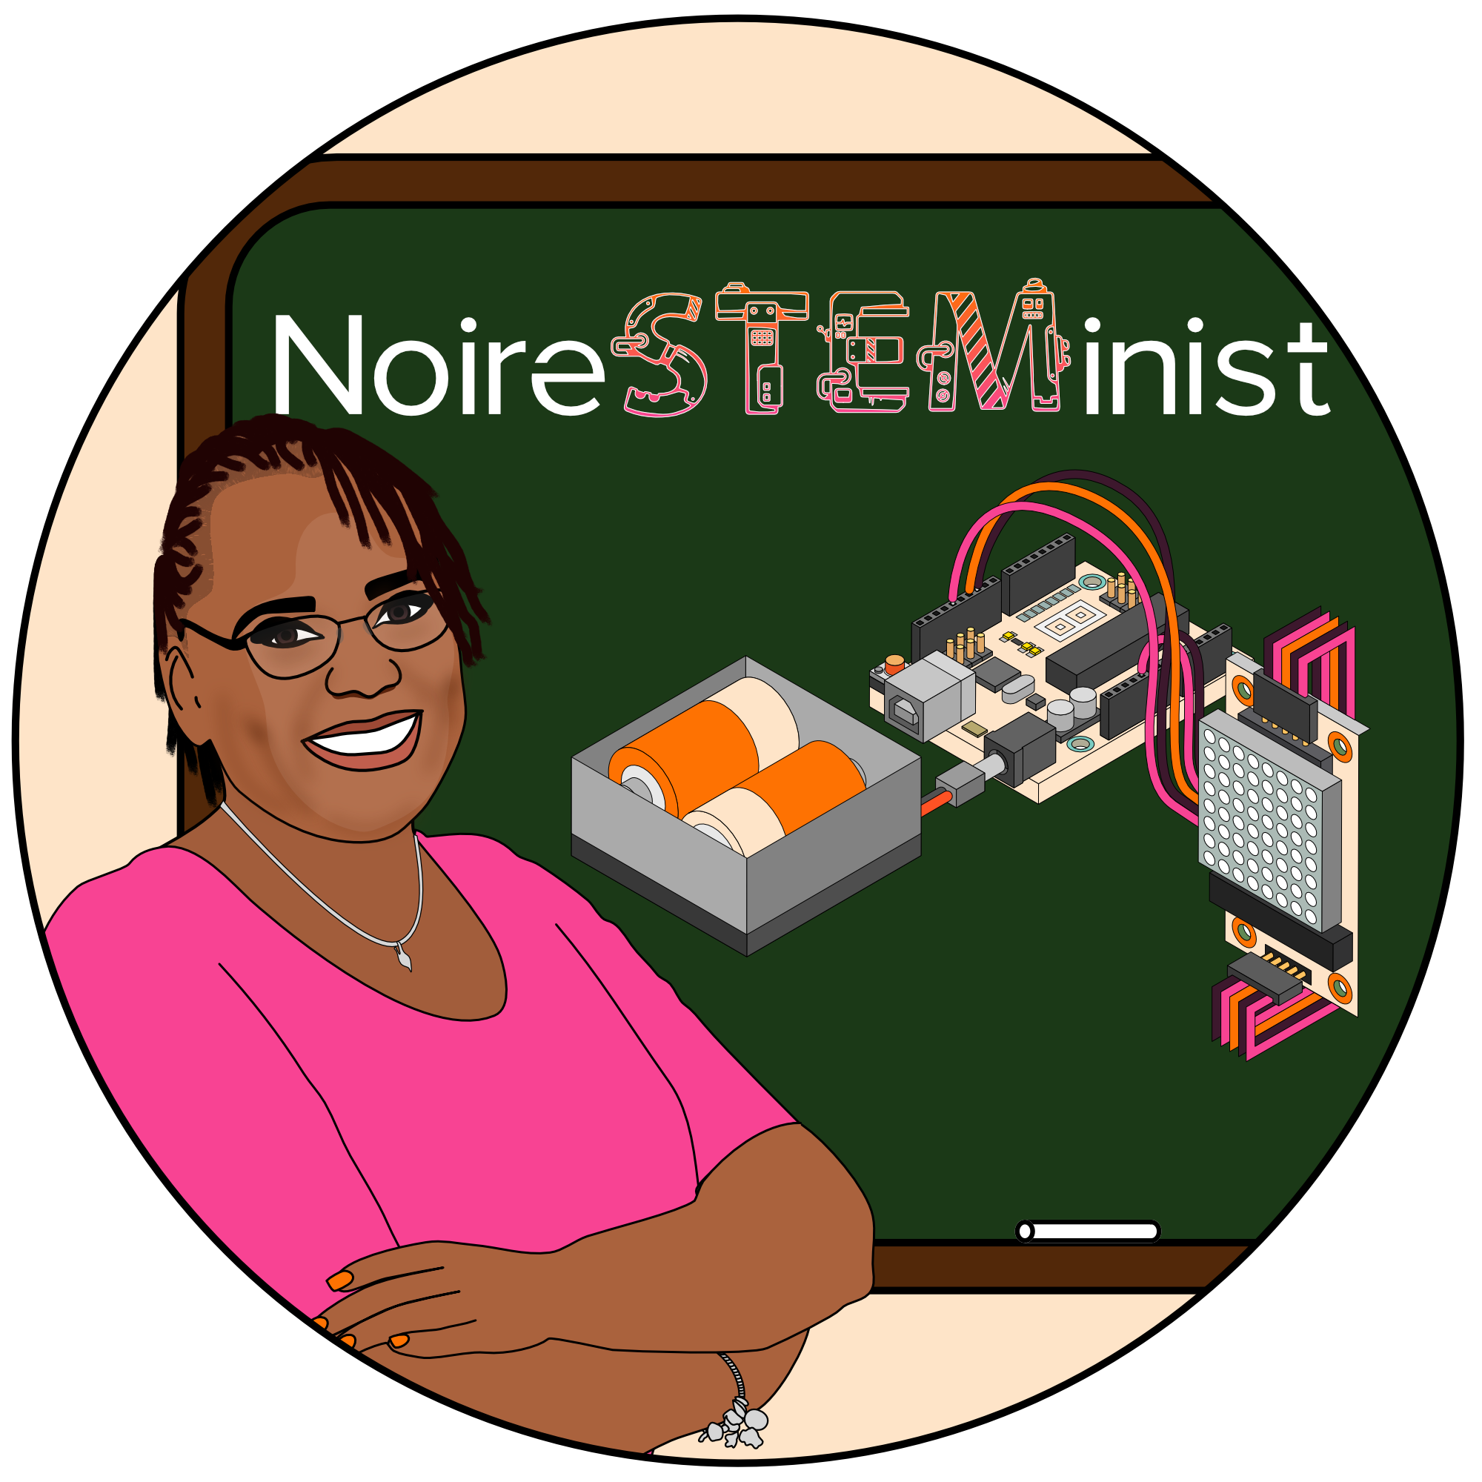
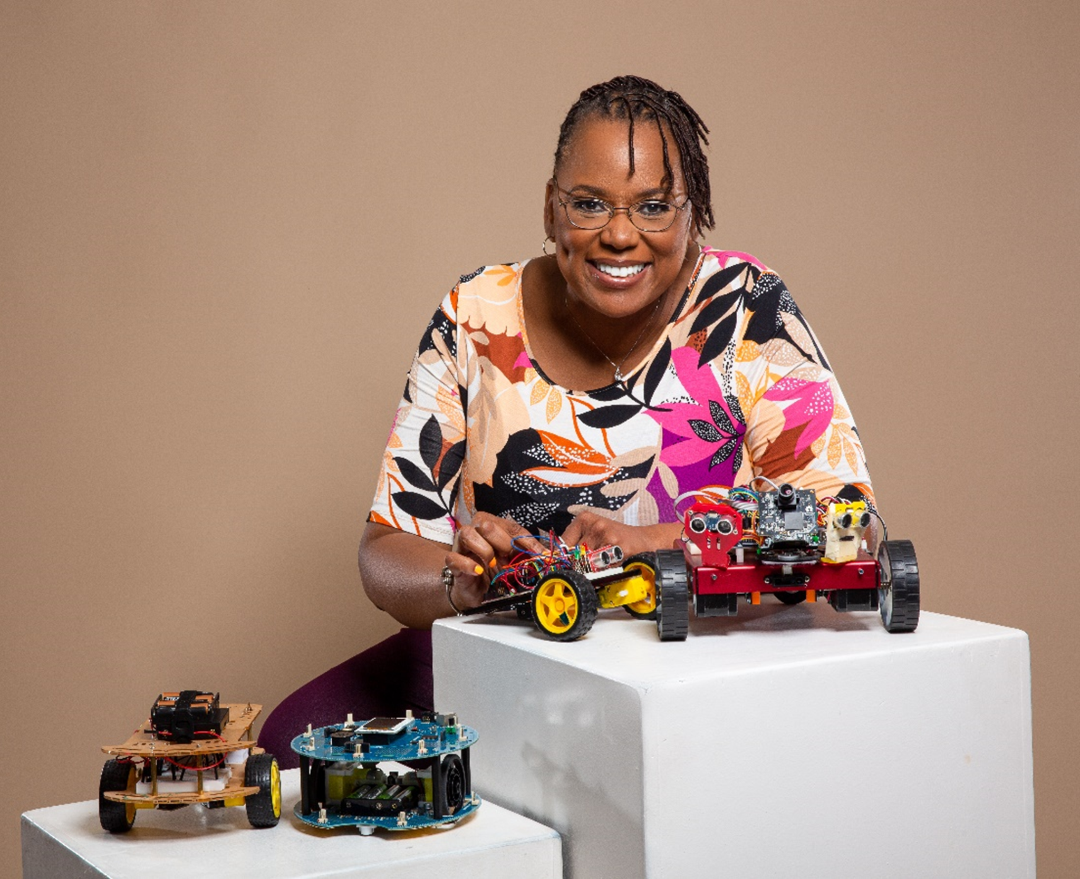
Robotics For The Streets:
Open-Source Robotics for Academics and The Community
Carlotta A. Berry, PhD
Professor and Endowed Chair
Electrical and Computer Engineering
Rose-Hulman Institute of Technology
Open-Source Hardware Trailblazer Fellow
Open-Hardware Summit
New York City, New York
Friday, April 28, 2023

Slide 2

Scholarship Reconsidered:
Intersectionality
Ernest Boyer states that the work of the professoriate may be separated into four separate yet also overlapping functions:
scholarship of discovery,
scholarship of integration,
scholarship of application, and
scholarship of teaching.
He proposes that there must be a more inclusive view of scholarship where these four dynamically interact to make an interdependent whole.
Boyer, E.L. (2015). Scholarship Reconsidered: Priorities of the professoriate. (2ND ed.). San Francisco, CA: Jossey-Bass.

Slide 3
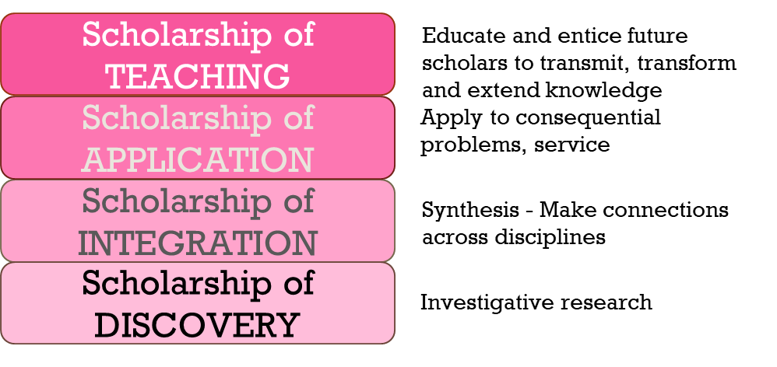
Scholarship Reconsidered:
Intersectionality
Knowledge is acquired through
research, synthesis, practice, teaching

Slide 4
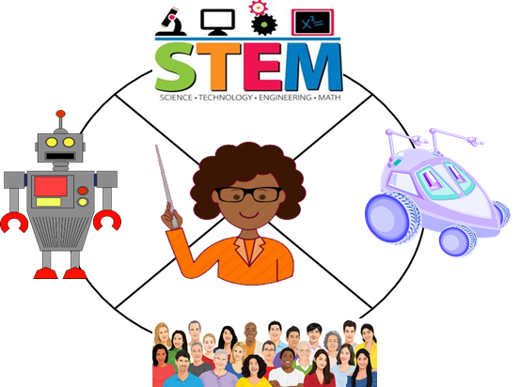
NoireSTEMinist
“I bring robotics and STEM to people and I bring people to robotics and STEM to educate and diversify the profession.”

Slide 5
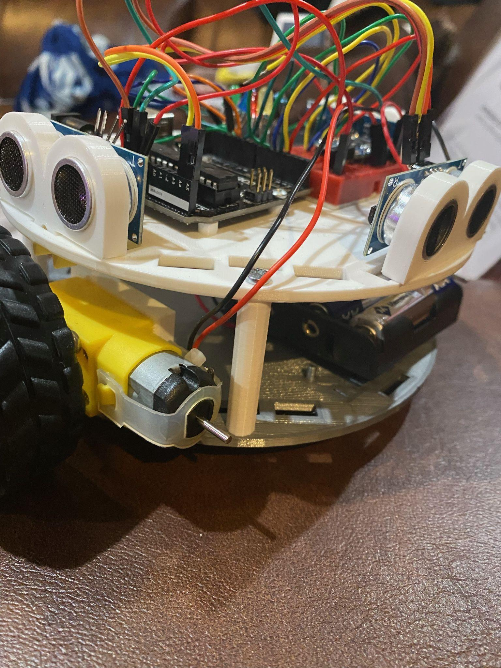
Motivation/Purpose
Low-cost and open-source to provide access to communities that may be marginalized or minoritized in STEM
Modular in order to be modified to add and remove various controllers, sensors, and peripherals
Flexible to be appropriate for outreach, education and research
Appropriate for novice to expert levels in robotics (K-12, University, Graduate, Academics, Makers, Professionals)

Slide 6
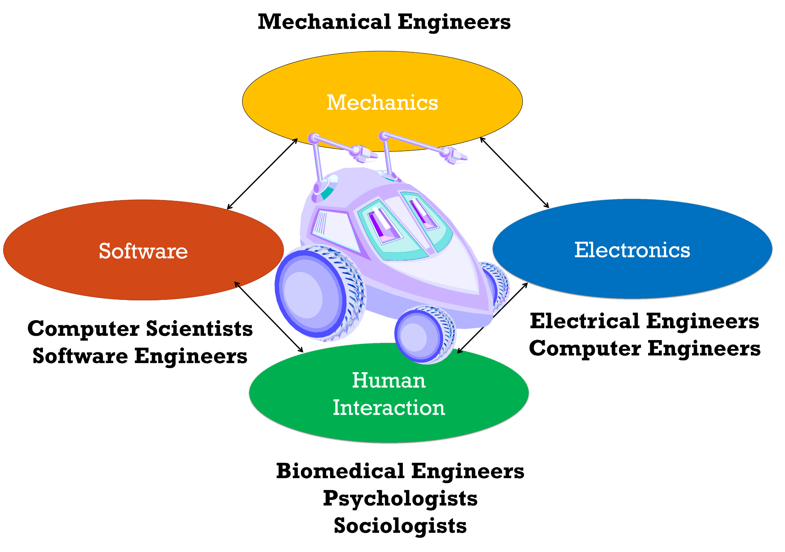
Mobile Robotics:
Multidisciplinary Connections

Slide 7
Robot Control Primitives
SENSE
PLAN
ACT

Slide 8
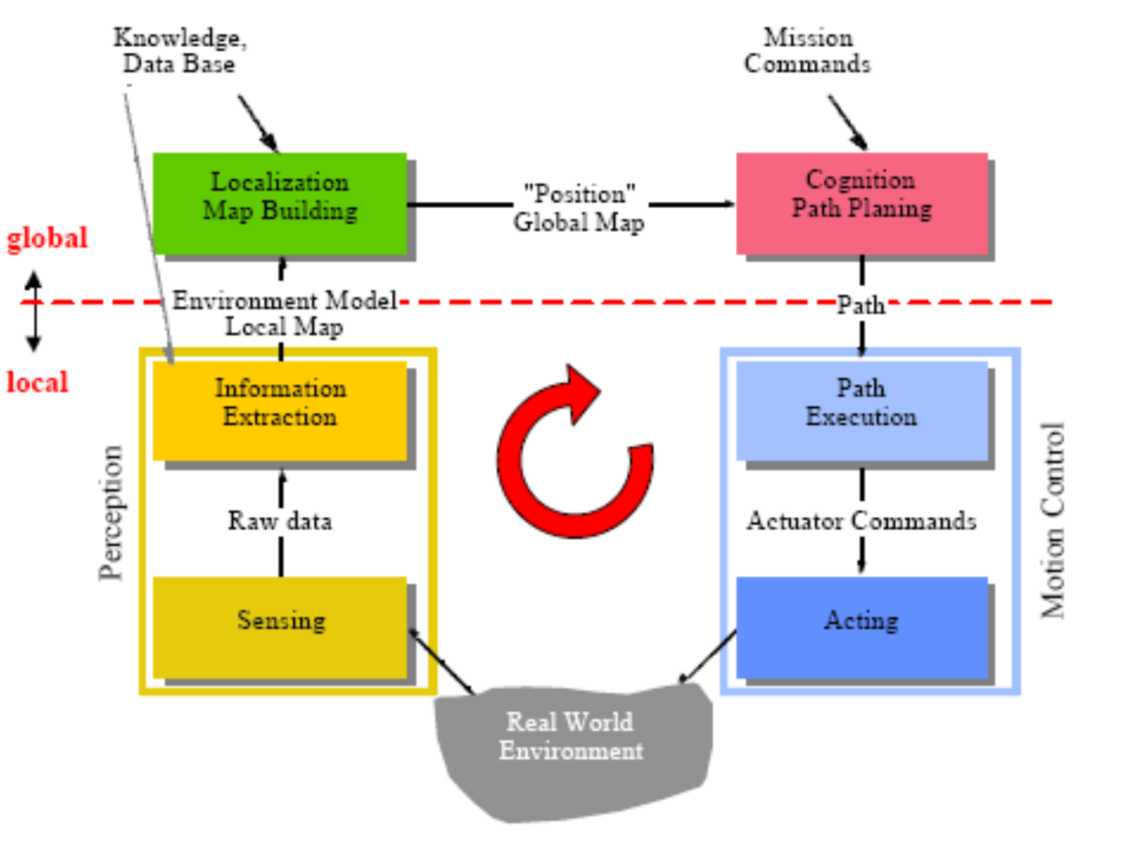
Mobile Robotics Control

Slide 9
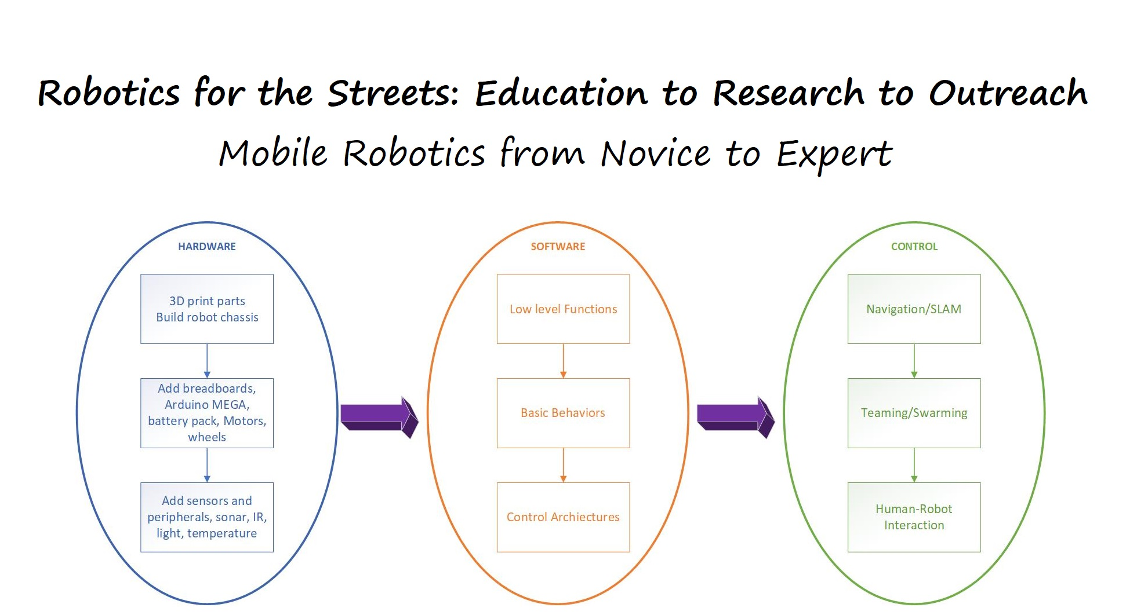

Slide 10
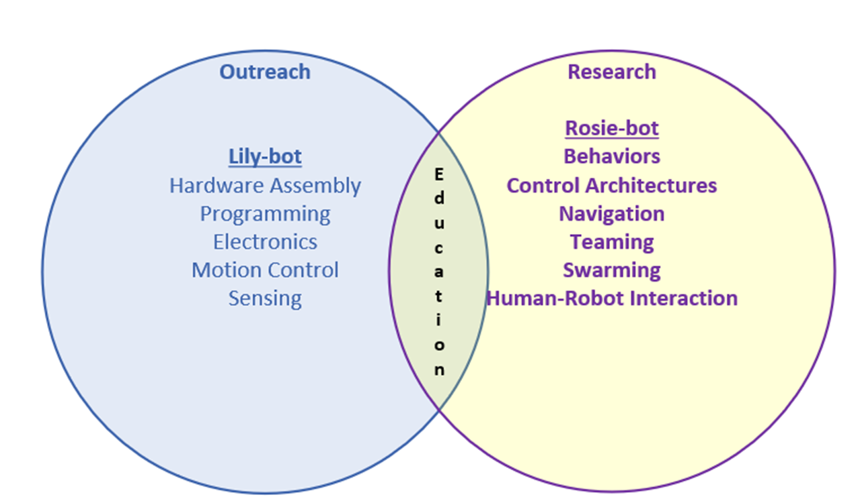
Design
Daisy-Bot

Slide 11
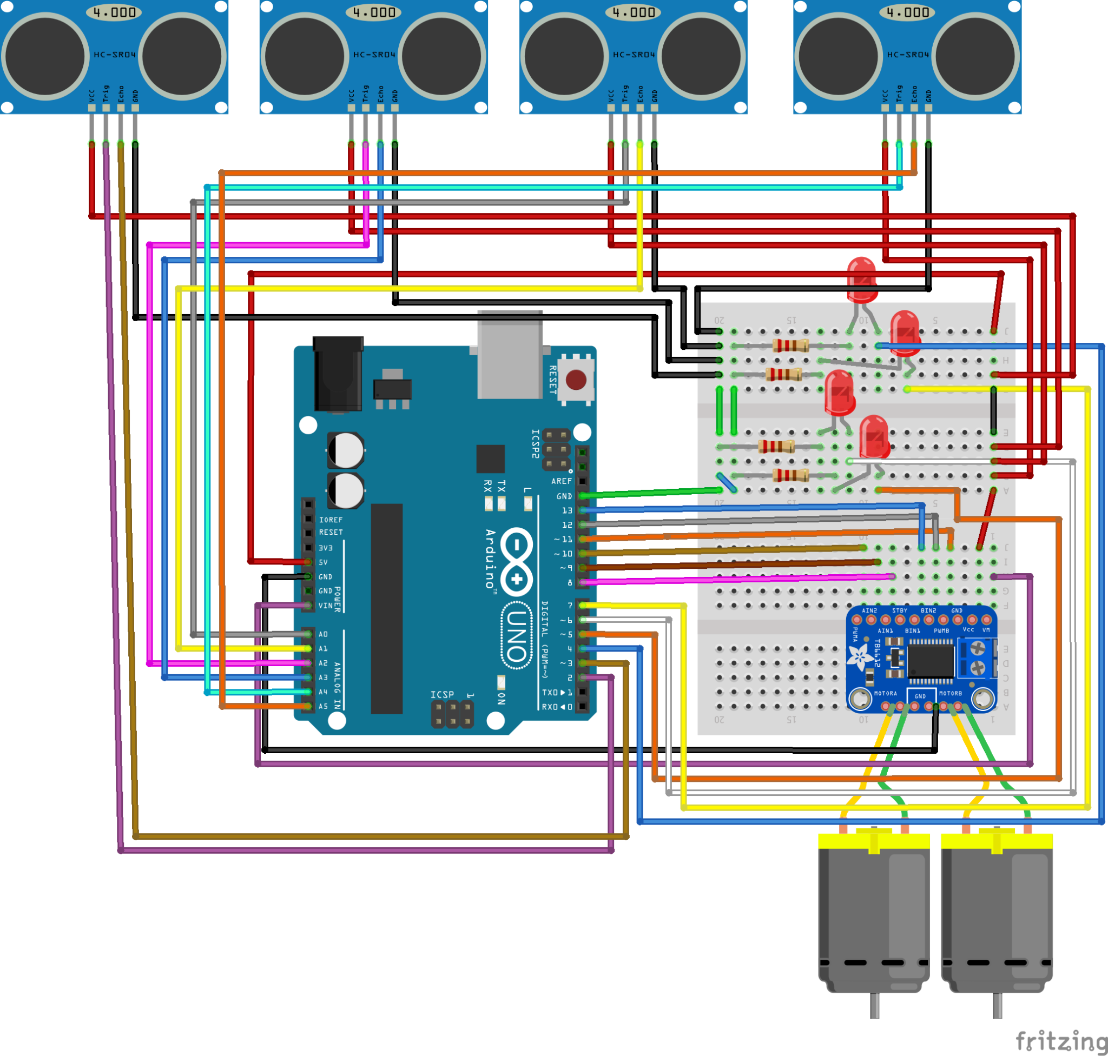
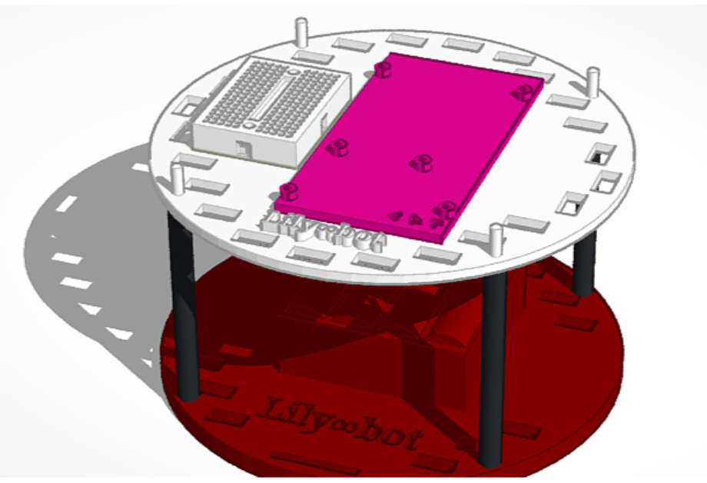
Design
Open-source robotics
  Open-source hardware
  Open-source software
Hardware
  Tinkercad
  SolidWorks
Parts
  3d printed
  Off the shelf parts
Electronics
  Fritzing
  Tinkercad
Software
  Arduino Sketch
  Scratch

Slide 12
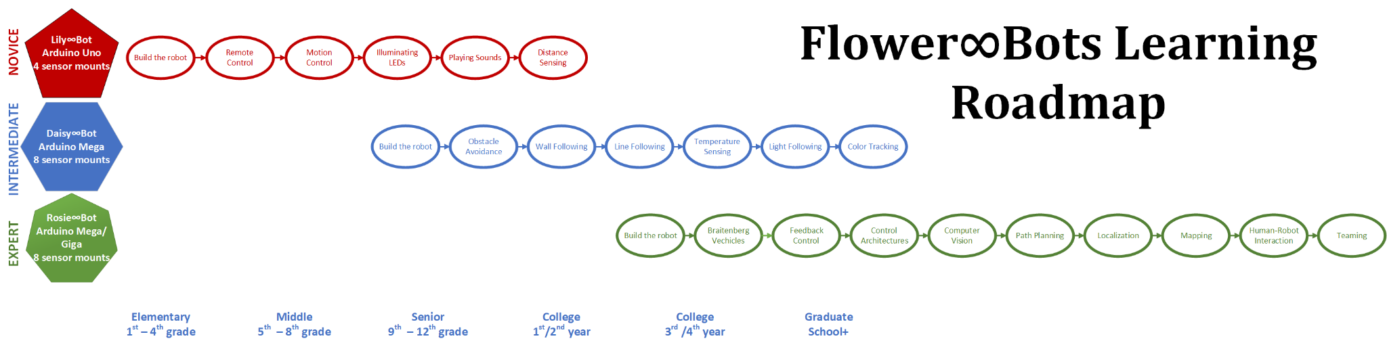
Learning RoadMap

Slide 13
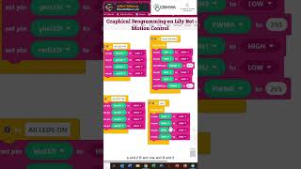
Open-Source Resources
Blogs on website
Videos on YouTube
Code and CAD files on GITHUB
Projects on Instructables
Projects on HacksterIO
Content shared on Social Media
  TikTok
  Instagram
  Twitter

Slide 14
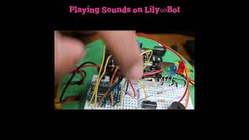
Tutorials
Motion Control
Obstacle Avoidance
Proportional Control
Bang-Bang Control
Blinking LEDs
Playing Sounds
Tracking Light
PlayStation/IR Remote Drive
More to come

Slide 15
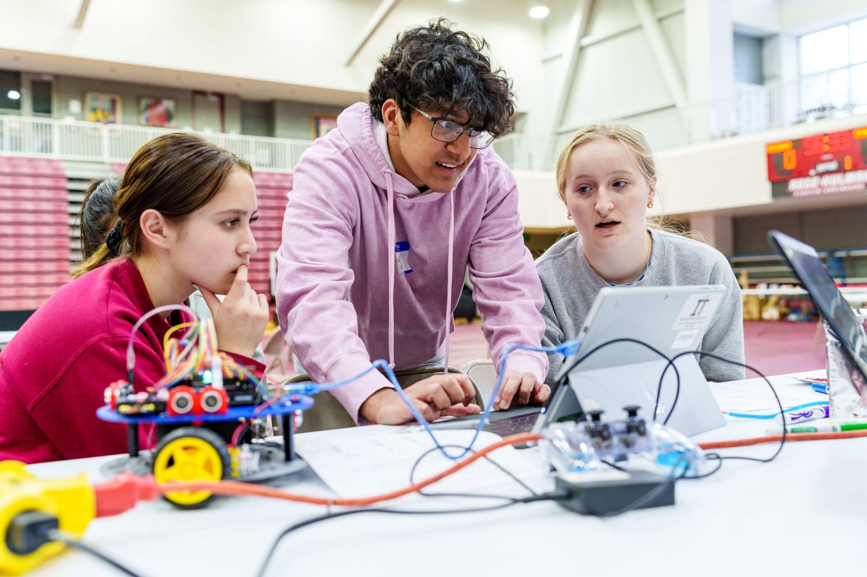
SPARK Design Competition
Rose-Hulman Institute of Technology, Rose Building Undergraduate Diversity Program
Middle and High school engineering design competition
Designed Daisy∞Bot to autonomously drive to a finish line
Designed robot to drive with PlayStation remote to navigate various terrains

Slide 16
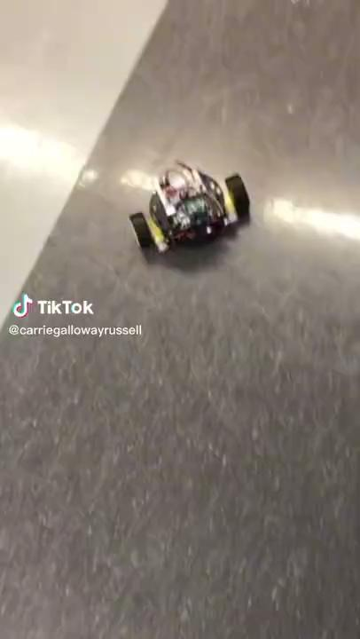
High School Students
Martin Luther King, Jr. High School, Detroit, MI
Robotics course
Built Lily∞Bot
Wired Electronics
Programmed the robot
Performed motion control
Working on obstacle avoidance
Used for Square One Education Innovation Challenges

Slide 17

Undergraduate Students
Indiana University Bloomington
Mechatronics Course
Built Daisy∞Bot and designed top for human interaction
Wired Electronics
Programmed the robot
Performed motion control
Performed obstacle avoidance

Slide 18
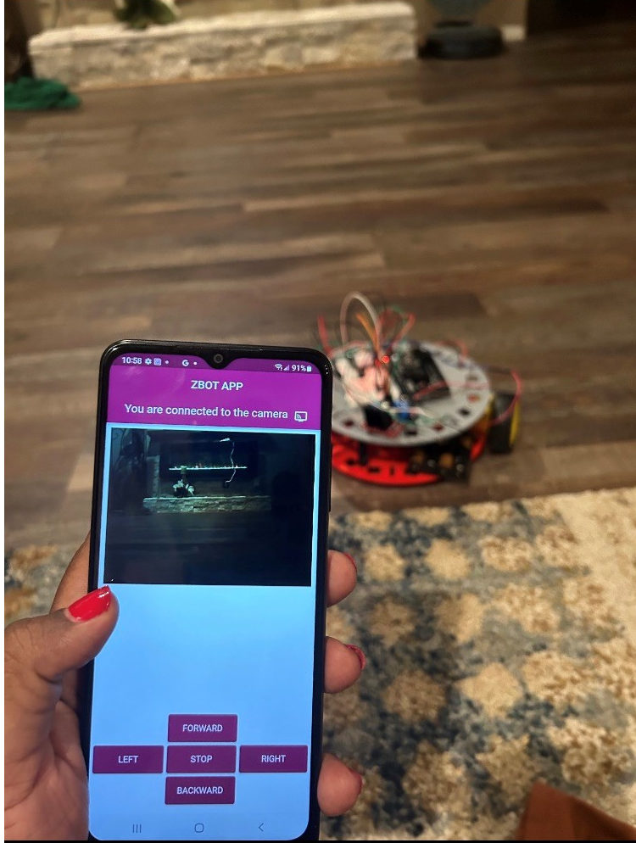
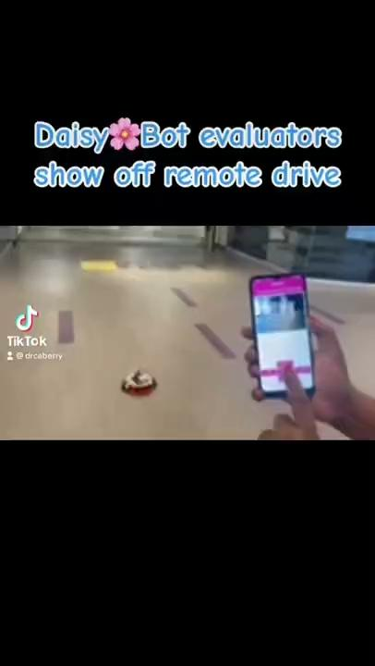
Graduate Students
Louisiana State University
Used Daisy∞Bot for artificial intelligence research
Mounted a camera on the robot
Created a remote interface on an Android phone
Remote controlled the robot and examined data

Slide 19
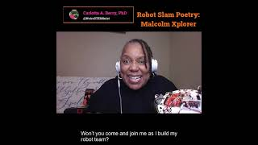
Robot Slam Poetry
Normalize seeing Black and Brown people doing robotics/STEM
Teach novice users about robotics concepts
Inspire kids to get excited about learning STEM
Illustrate the intersections between art and STEM

Slide 20
Flower∞Bots Evaluation
Recruited participants from social media, Black In Robotics, Black In Engineering, NSBE, Future of Mechatronics and Robotics Engineering Education, AA-roboticists & AA-PhD-CS listerves
Shipped either a Lily∞Bot or Daisy∞Bot, sensors and peripherals to participants
Built the robot, wired electronics, and programmed several learning activities
Completed online survey about the experience
Academics | 29
Practitioners | 10
Graduate Students | 4
Post-Docs | 1
TOTAL | 44
Lily∞Bot | 23
Daisy∞Bot | 21
TOTAL | 44

Slide 21
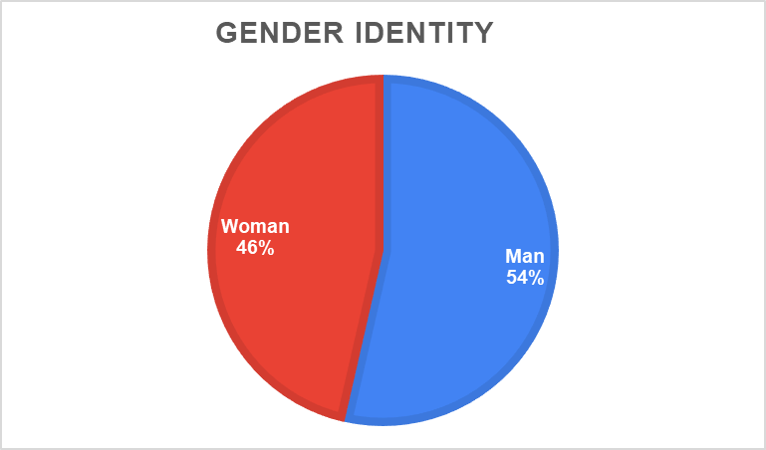
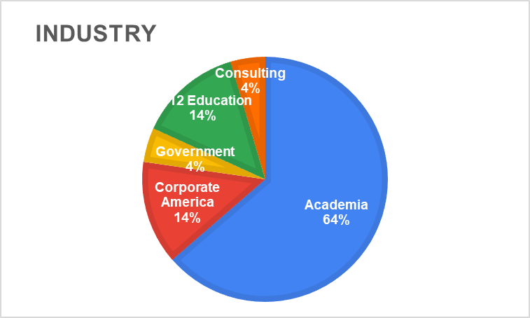
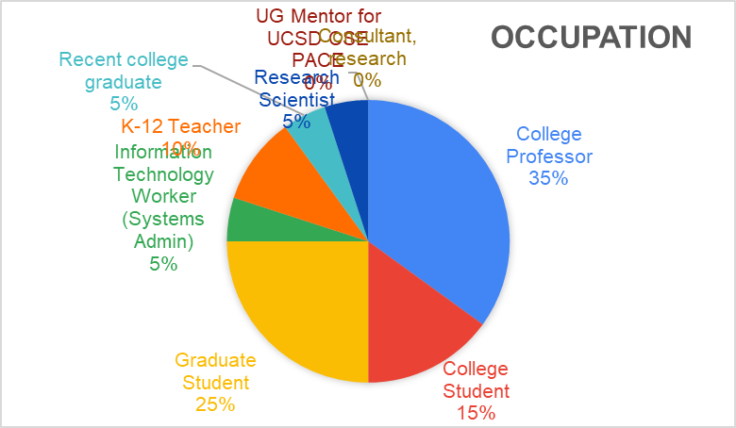
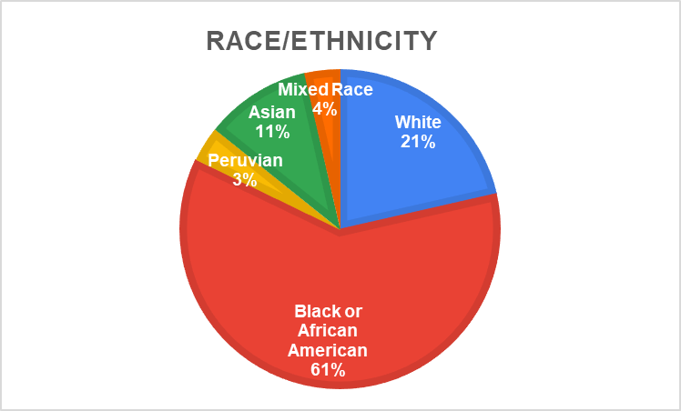
Evaluation Results:
Participant Demographics (n=22 [50%])

Slide 22
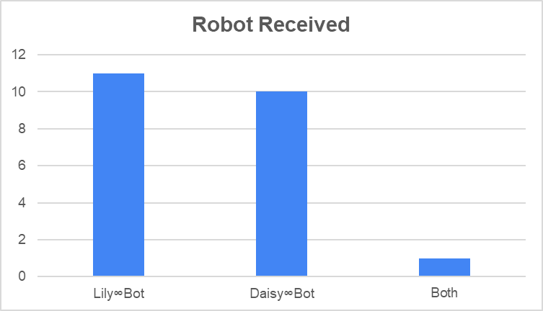
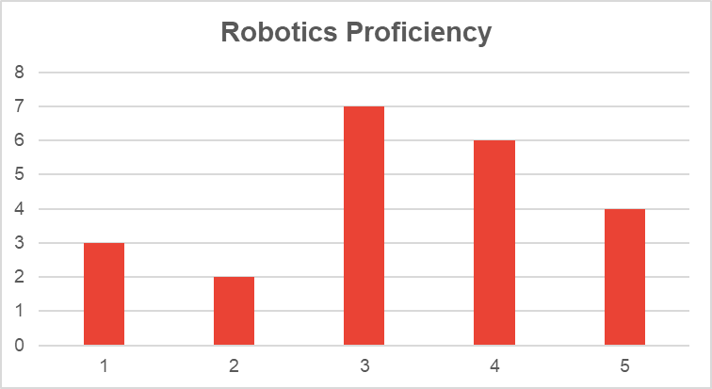
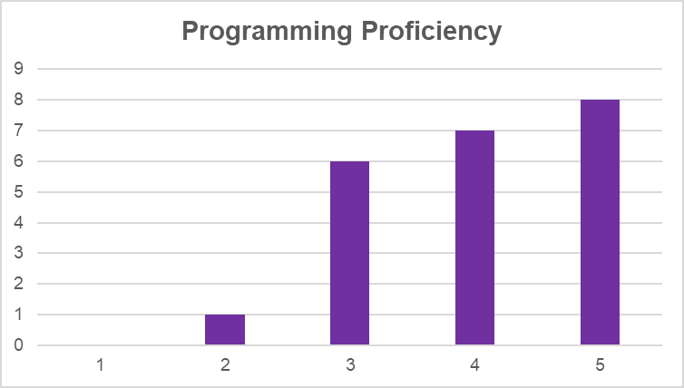
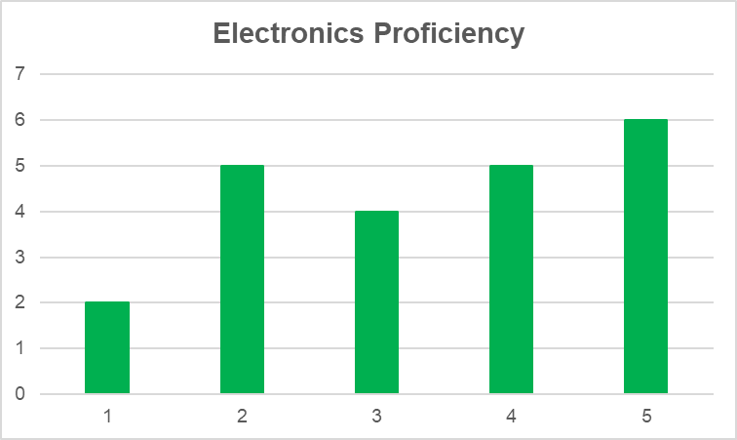
Evaluation Results:
Participant Demographics (n=22 [50%])
1 - least proficient
5 - most proficient

Slide 23
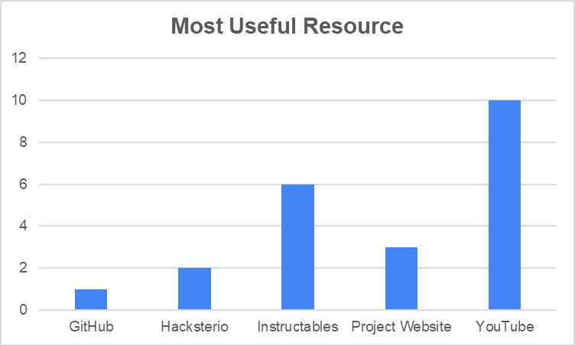
Evaluation Results:
Learning Activities
Some users struggled with building, wiring and programming. It was dependent on how much prior experience they had.
Some requested more explanations of how things work like breadboard, sonar, photoresistors, and LEDs.
Some requested a PDF for robot assembly with parts labeled in the kit in addition to videos
A few issues with 3d printing tolerance for motor mounts
Notes:
Low-cost
Modular
Flexible
Appropriate for various levels

Slide 24
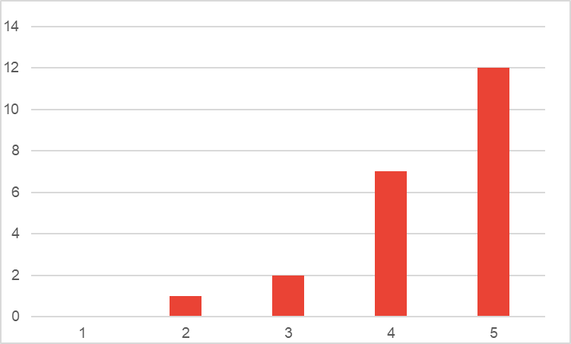
Evaluation Results:
One goal of this work is for the Flower∞Bots to be used for K-12 outreach to get more young people interested in and excited about STEM. On a scale of 1 to 5, with 5 being very well, how well do you think these robots meet this mission.
“Right now, the documentation (or at least the parts I used) seem like they would be hard to navigate by a K-12 newcomer (student or teacher) to the mechatronic systems space. It wasn't always clear there to turn to continue the robot exploration, and tools like the Arduino IDE and Arduino board itself would likely need more explanation to get up and running. (For example, in my past experience, just programming an Arduino takes quite some time and coaching for newcomers.) Tools that are truly plug and play (Makey Makey is one example that comes to mind) can be easier to jump into, but often provide more limited associated learning opportunities (a definite con of these alternatives). KiwiCo and BirdBrain might be other examples to serve as inspiration for accessible onboarding.”
“I think this is an such an incredibly platform to introduce young people to robotics. I haven't seen a robot that is so accessible with hardware and assembly that also allows for such a large level of expansion. I could really take this robot in any direction as my learning grows and it isn't just limited to foundational knowledge. It's really exciting because it provides such a huge opportunity to learn things that might have taken me a much longer time to learn due to inaccessibility. It's really lovely because I now have one project I can focus on that allows me to learn about mechanics, circuitry, as well as programming.“
“I used it with my children in a public library and it drew a lot of attention and some involvement from other children. My children kept asking if we could add parts and make it do more and more things. They asked intelligent questions about the hardware, software, and electronics aspects as we went as well.”
Notes:
Low-cost
Modular
Flexible
Appropriate for various levels

Slide 25
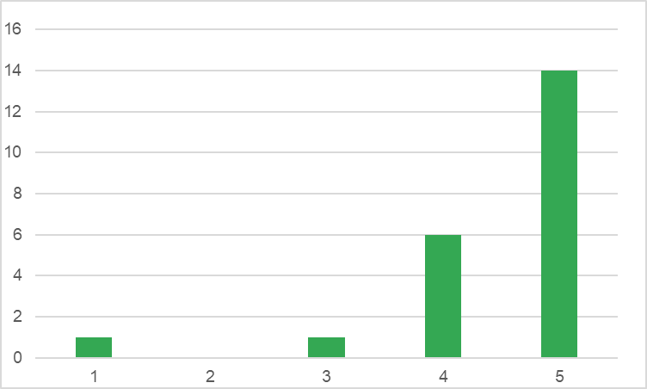
Evaluation Results:
One goal of this work is for the Flower∞Bots to be used by academics for teaching electronics, design, and robotics for high school or college freshmen. On a scale of 1 to 5 with 5 being very well, how well do you think these robots meet this mission?
“These bots do a great job with allowing for students to explore CAD, 3D printing, design and building, electronics with breadboard and basic circuits and coding. It covers all the bases. I think for an open source robot, it's hard to beat the cost and flexiblity of the bot.”
‘The platform seems good for these types of efforts. Like I mentioned earlier in the form, I've spun up similar resources for my undergraduate teaching. It could be nice to have a preexisting open-source robot to use, rather than reinventing the wheel for this each time someone tries it. One thought is that for certain parts of the assembly, laser cutting could be much faster and more practical than 3D-printing. I am thinking, for example, about the energy cost for spinning up this platform for my up-to-180-student undergrad class. We used this in a class for undergraduate first years where they are introduced to topics related to computing and they expressed enthusiasm for getting to work with the robots and have a hands on experience.”
“I used the DaisyBot and I think the range that it provides is perfect. Expanding functionality is incredibly realistic and it teaches things that can be easily applied to larger and more complex projects down the line. It uses accessible and popular enough hardware that it's easy to find information that will help to gain confidence and allow you to branch out later on. I find it so exciting.”
Notes:
Low-cost
Modular
Flexible
Appropriate for various levels

Slide 26
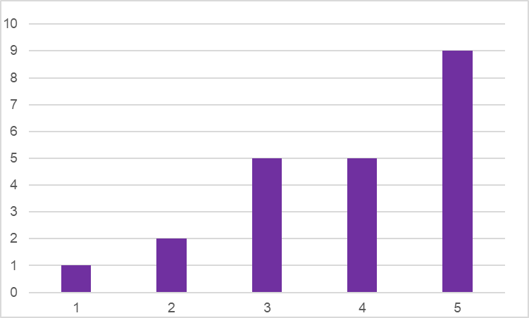
Evaluation Results:
One goal of this work is for the Flower∞Bots to be used by academics for advanced courses or conducting research in robotics. On a scale of 1 to 5 with 5 being very well, how well do you think these robots meet this mission?
“It can be used for some aspects of research such as swarm uses or perhaps mock-up purposes. It might be too small for some advanced research where larger batteries and hardware are needed onboard. So it very much depends upon the exact nature of the research. However, for control via a computer and using multiple agents to do tasks, the platform is perfect.”
“The Flower Bots on their own do not provide any novel functionality that other differential drive robots provide for higher level education. Without more advanced components like a Raspberry Pi or an RGB camera I am not sure what applications the Flower Bots can have in advanced courses.”
“I'm sure there is a lot of cost-vs.-practicality on this front. For our related classes at Oregon State, though, we typically need at least a Raspberry Pi for the hardware platform to be viable (i.e., ROS compatibility is very important). Note that I do generally use rosserial to interface with Arduinos, but I can't run ROS in the standalone way I would wish on an Ardunio. Similar hardware could work with a Raspberry Pi and Pi Pico for advanced robotics teaching purposes, but this would increase the cost and likely inhibit some useful resources for getting started (for example, the Pi Pico documentation isn't quite as rich as the Arduino resources out there).”
Notes:
Low-cost
Modular
Flexible
Appropriate for various levels

Slide 27
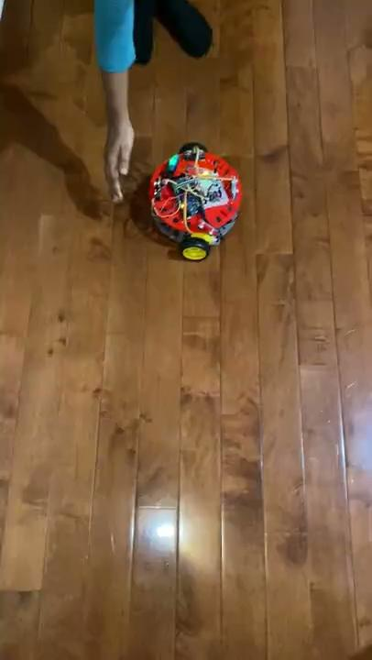
Evaluation Results:
Sample Comments
“….I will definitely showcase Lily∞Bot this summer in several K-12 camps that I am developing for STEAM enrichment and programming.”
“I would love to continue to collaborate on this. In addition to my robotics classes, I teach a summer camp at U of M and UDM where students look at similar projects. My goal with robotics is to meet students where they are at, so I would like to see if I can make the Lilybot "flexible" for use with students with no robotics experience up to ones that have college ready experience.”
Notes:
Low-cost
Modular
Flexible
Appropriate for various levels

Slide 28
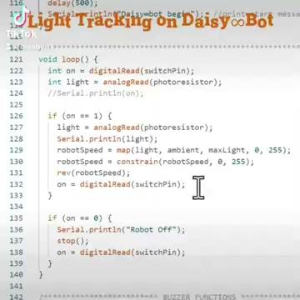
Evaluation Results:
Sample Comments
“Things my younger children asked (or would need to be taught if using in high school and they haven't had a lot of PRACTICAL electronics) included how the breadboard worked (many people didn't understand how the connections inside were structured until I showed them), and then people less familiar with programming need to know how to alter the code. I also wished that the battery strap was positioned 90-degrees in the other way so that it could easily be slid in and out between the motors. A more simple 9V case would also be appreciated (like just a connector) as the enclosed case made it very difficult to slip the battery in and out.”
Notes:
Low-cost
Modular
Flexible
Appropriate for various levels

Slide 29
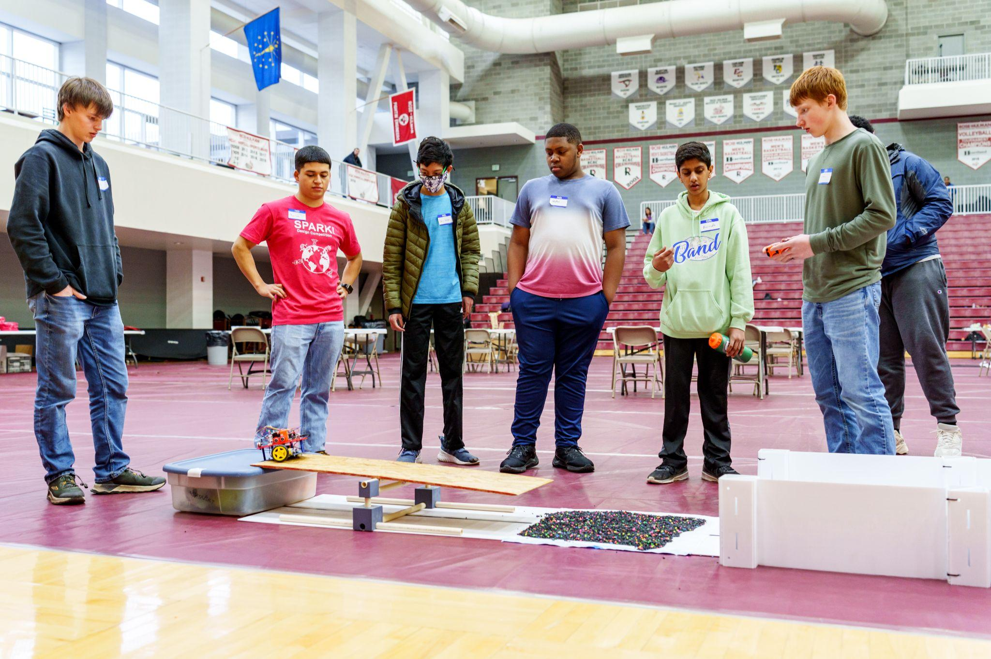
Evaluation Results:
Sample Comments
“I believe the robot with the heavy documentation is an excellent platform for learning robotics, and more importantly how different disciplines aggregate within this field. To repeat, this is now a critical component to introduce students to the subject at large and to robotics research”
Notes:
Low-cost
Modular
Flexible
Appropriate for various levels

Slide 30
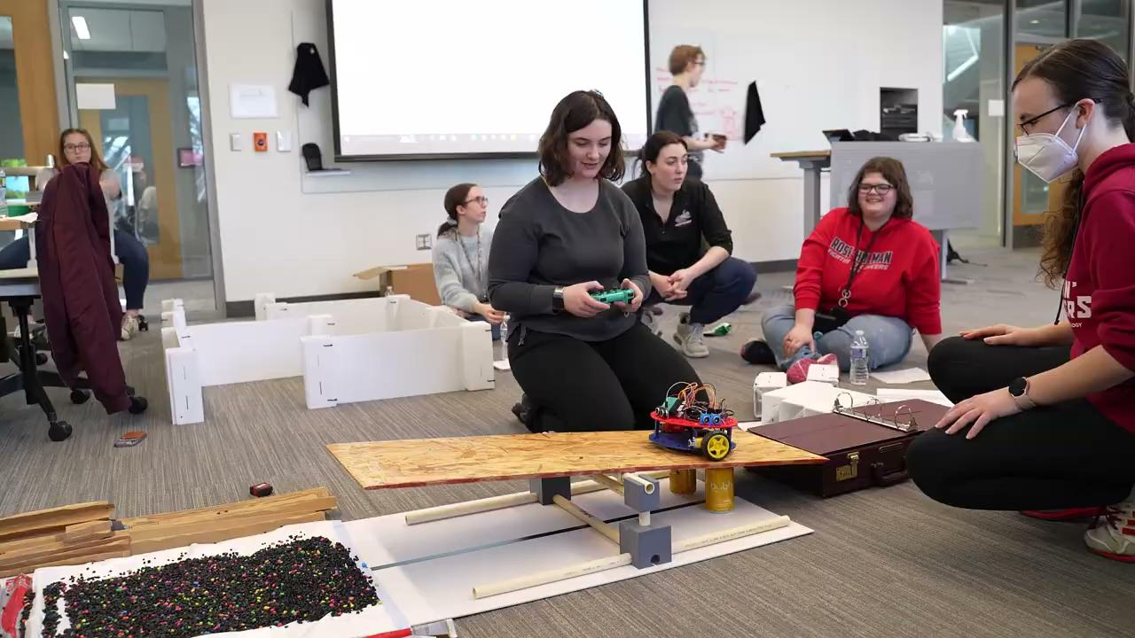
Conclusions
Robotics is ideal for showing connections between multiple disciplines
Robotics is uniquely equipped to create intersections between teaching, research, and service
Robotics is used to educate and entice future scholars to transmit, transform and extend knowledge
Robotics is a great tool for recruiting diverse populations to STEM
Open-source robotics can help address issues with equity and bias in STEM by increasing access and affordability to a more diverse community

Slide 31
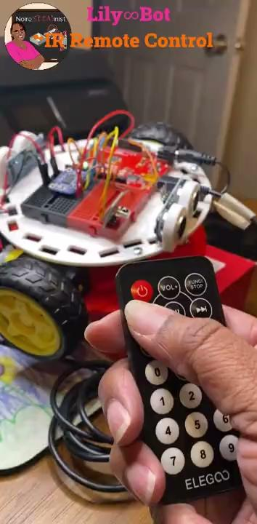
Future Work
Present paper on Flower∞Bots at Frontiers In Education Conference
Publish article about Flower∞Bots in IEEE Transactions on Education Journal
Create more curriculum and activities for Flower∞Bots (YouTube, HacksterIO, Instructables, GitHub)
Support several faculty planning to use robots for research, class, and summer programs
Launch KickStarter to garner support for Flower∞Bots
Sell robots on DFRobot.com
Collaborate with Arduino and Viam Robotics on robotics education projects

Slide 32


Black In Engineering Black In Robotics
Support Black faculty, researchers, practitioners and students in engineering
Serve as a resource for community building
Share experiences with implicit bias and systemic racism
Provide action items to address racial injustice
Identify and connect with allies, advocates, collaborators, and sponsors
Bring together Black researchers, professionals, academics and students in robotics
Advocate for more diversity, inclusion, and equity in organizations
Ensure a seat at the table during development, test, and deployment of robotic systems
Amplify collective voices for social justice

Slide 33
Thank You
Research Students
  Katie Collins
  Sean Hyacinthe
  Alejandro Marcenido Larregola
  Josiah McGee
Technicians
  Mark Crosby
  Gary Meyer
  Jack Shrader
Administrative Assistant
  Ashley Lowe

Slide 34


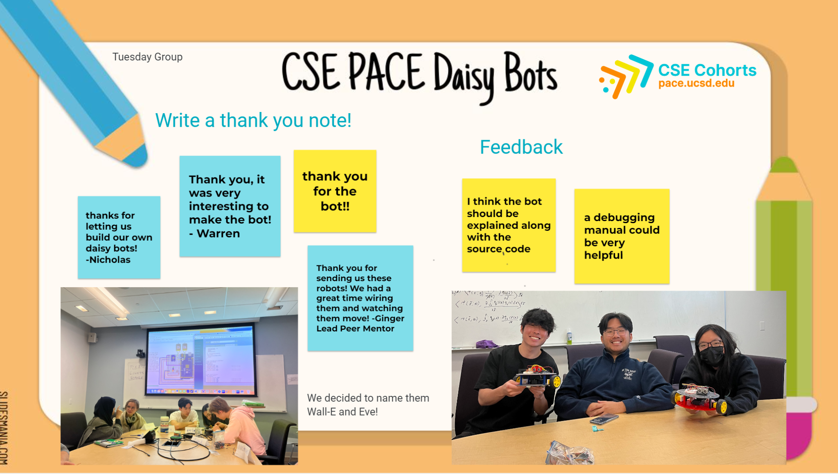
Thank You
Open-Source Hardware Association
Sloan Foundation
Kat Scott
Alicia Gibb
Lecia Ductan
Lee Wilkins
Robot Evaluator Participants
Mentors
  Jinger Zee
  Brandon Stafford
  Huaishu Peng
  César Garcia Saez
  Elizabeth Hendrex

Slide 35
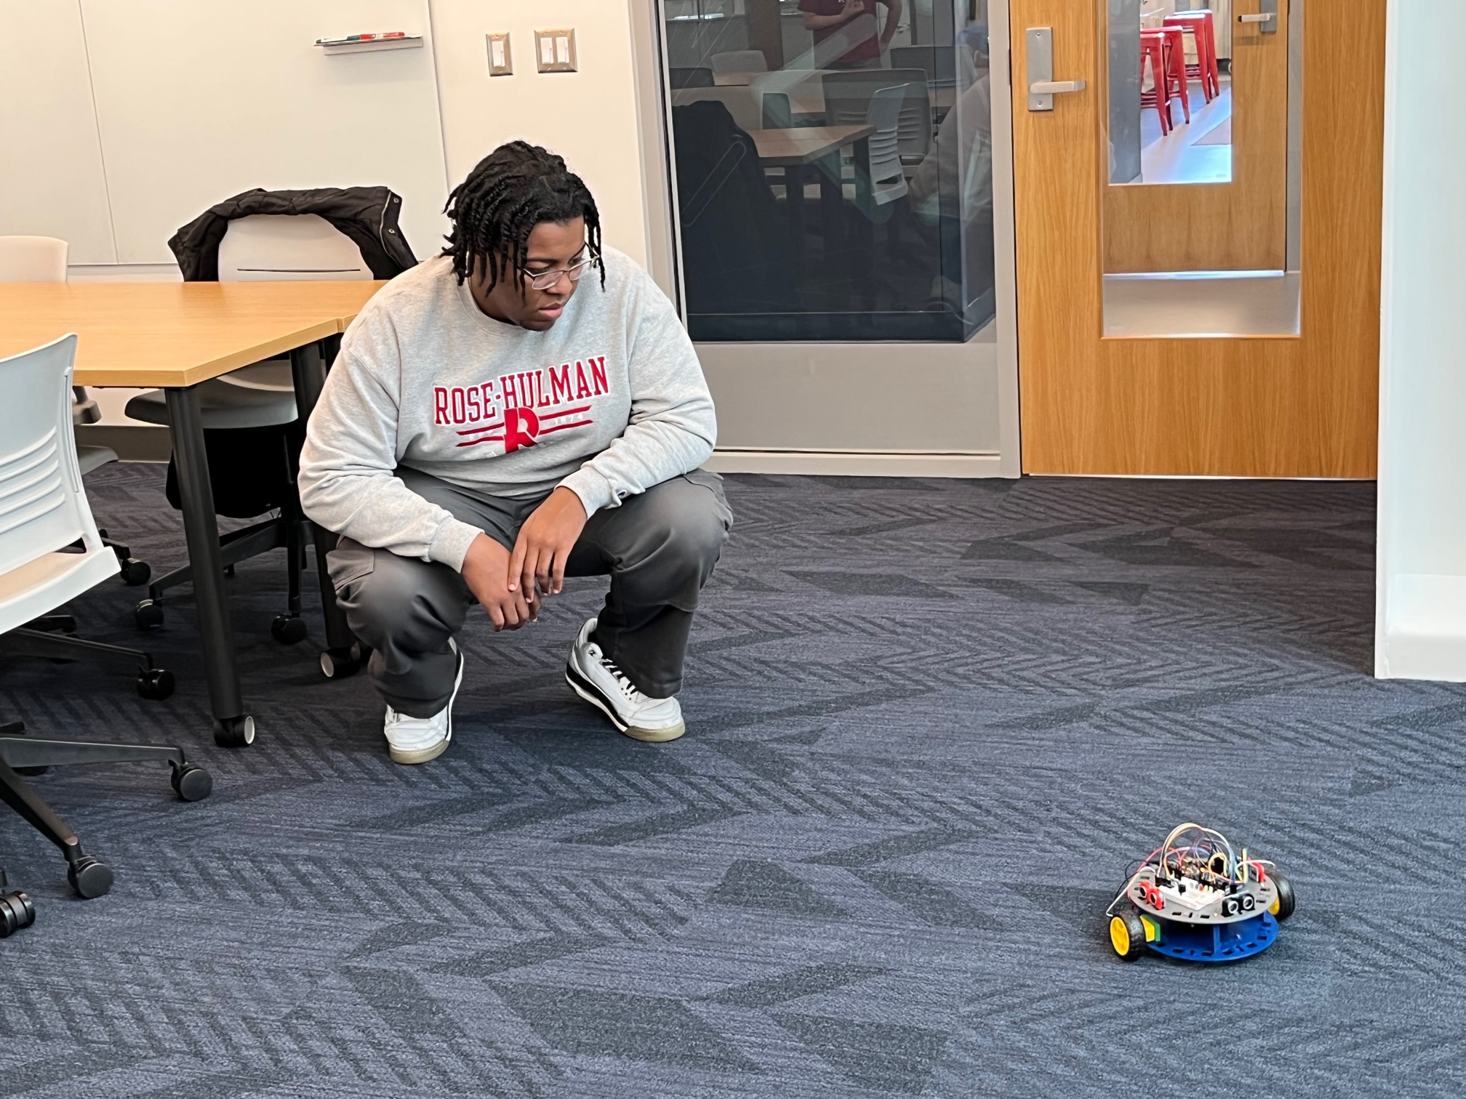
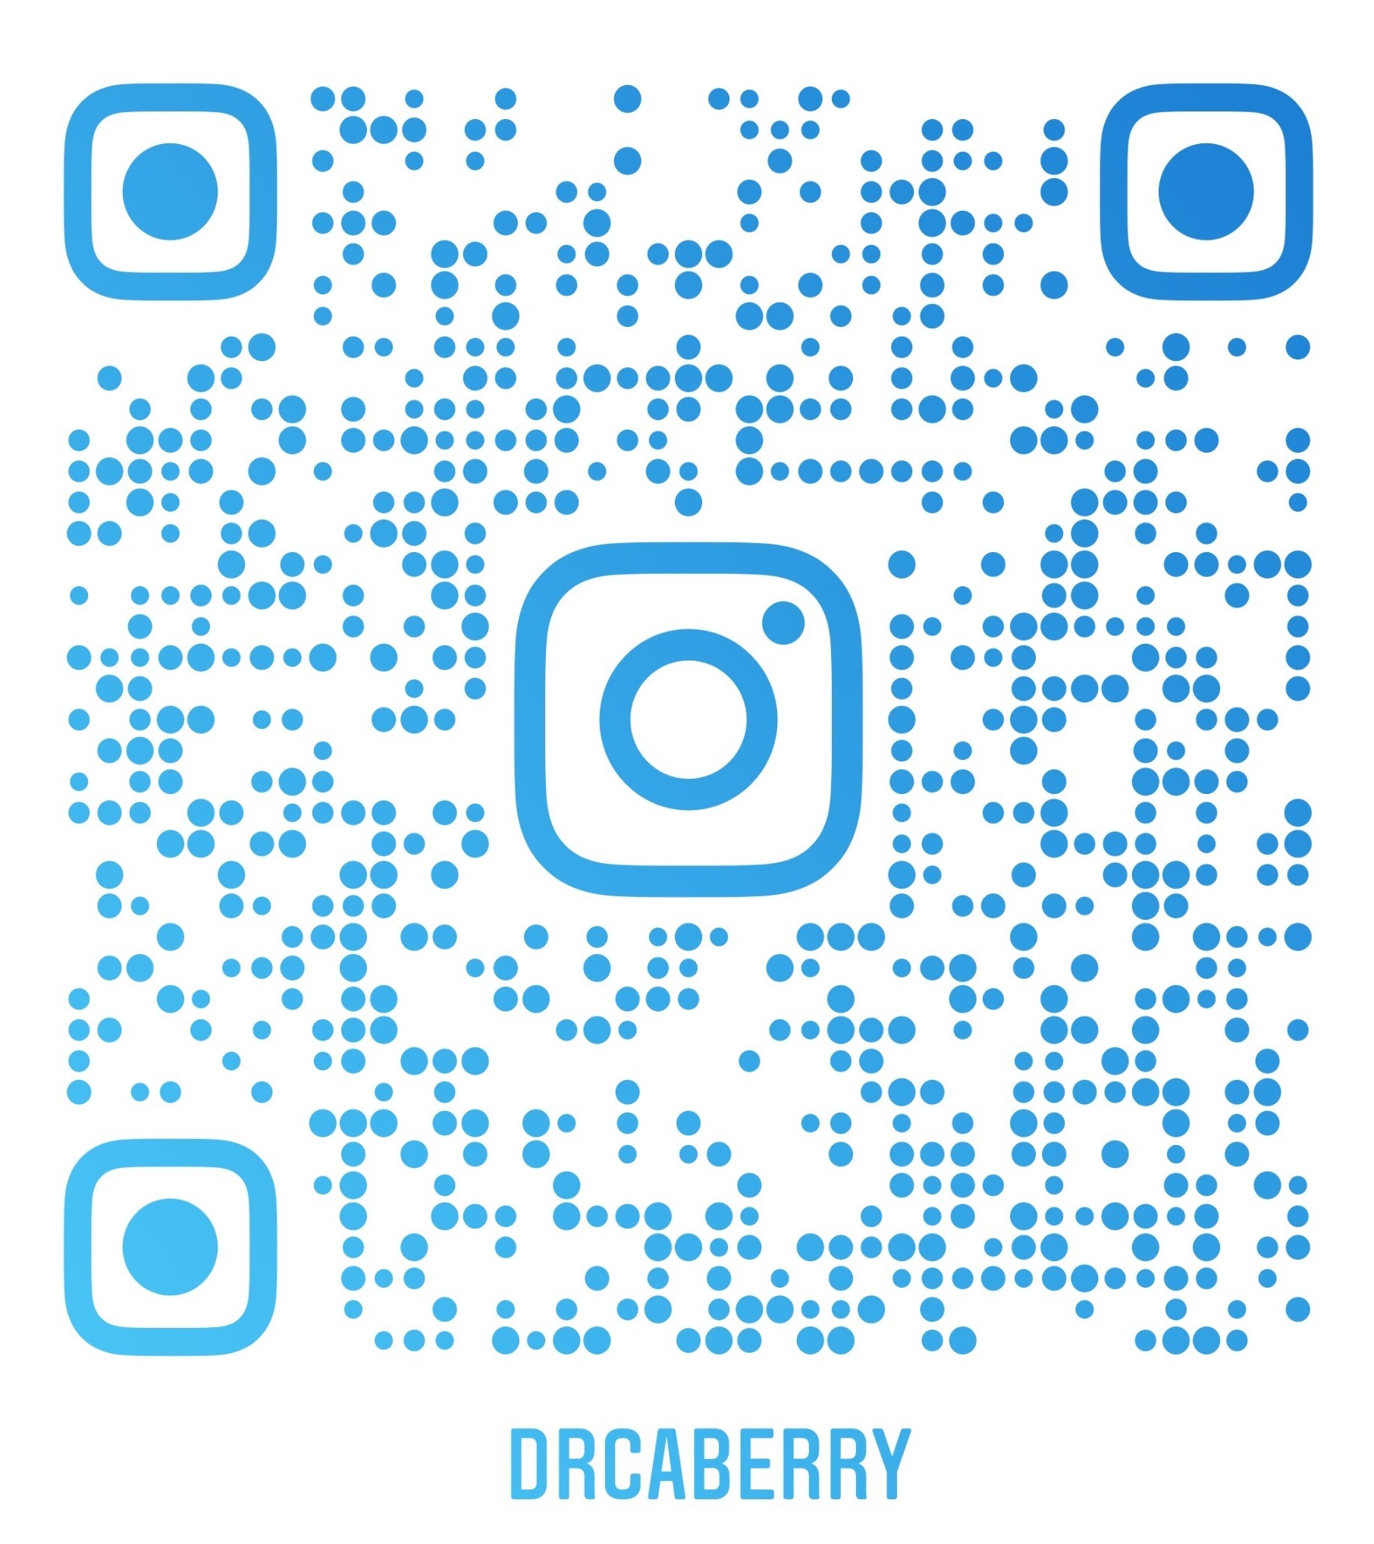
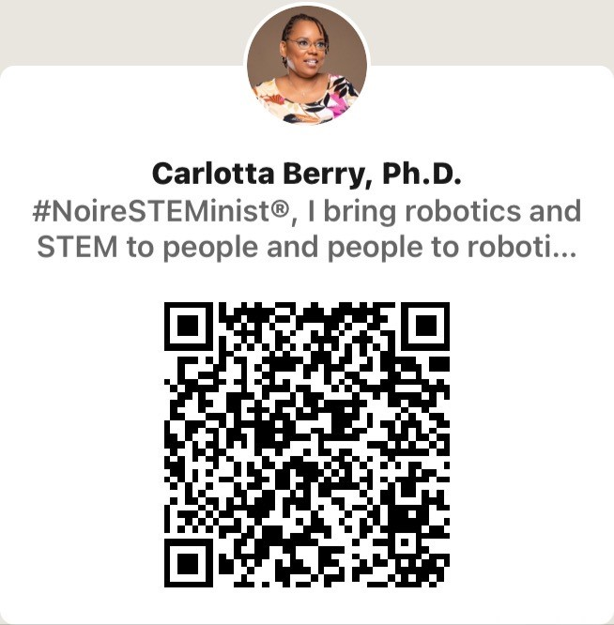

Questions
Email: berry123@rose-hulman.edu
School Website: wordpress.rose-hulman.edu/berry123
Personal Website: NoireSTEMinist.com
YouTube: Youtube.com/carlottaberry
GitHub: https://github.com/berry123/Lily-Bot
HacksterIO: https://www.hackster.io/berry123/
Instructables: https://www.instructables.com/member/carlottaberry
Social Media: @DrCABerry

