Slide 1
Computational Intelligence applications in multi-disciplines
Jun Shen
Adjunct A/Prof, UOW Malaysia KDU

Slide 2
The Agenda
Background
  Micro Learning as a Service
  (Proteomics) Knowledge as a Service
  Mobility as a Service

Slide 3


Open learning

Slide 4
MLaaS
Micro Learning as a Service (MLaaS), to provide personalized OER delivery, in micro learning mode.
Educational data mining (EDM) and learning analytics (LA) are key concepts that help modelling learners and recognizing potential learning resource features.

Slide 5

Background
Micro Learning
Micro learning booms with the wide use of mobile devices.
Micro learning refers to short-term learning activities on small learning units.
Typically micro learning activities are shorter than 15 minutes, and through mobile devices.

Slide 6

Background
Open learning and its acceptance
Open Learning is currently suffering from low completion rate.
This is mainly because learners fail to conduct effective time management.
Also, learners deem it is not easy to find appropriate resources they want, or the chosen resources do not match their expectation.

Slide 7
Background
Challenges for Micro Open Learning
Being on the go is fraught with distractions.
It could be very difficult for learners to quickly choose the preferred and suitable course chunks in a timely manner.
Personality and learning styles play significant roles in influencing academic achievement.

Slide 8

Background
Challenges for Micro Open Learning
In the current situation, learning resources are generally divided and wrapped up by education providers or courses lecturers.
Personalized curriculum sequencing is an important research issue.
Cold Start Problem

Slide 9
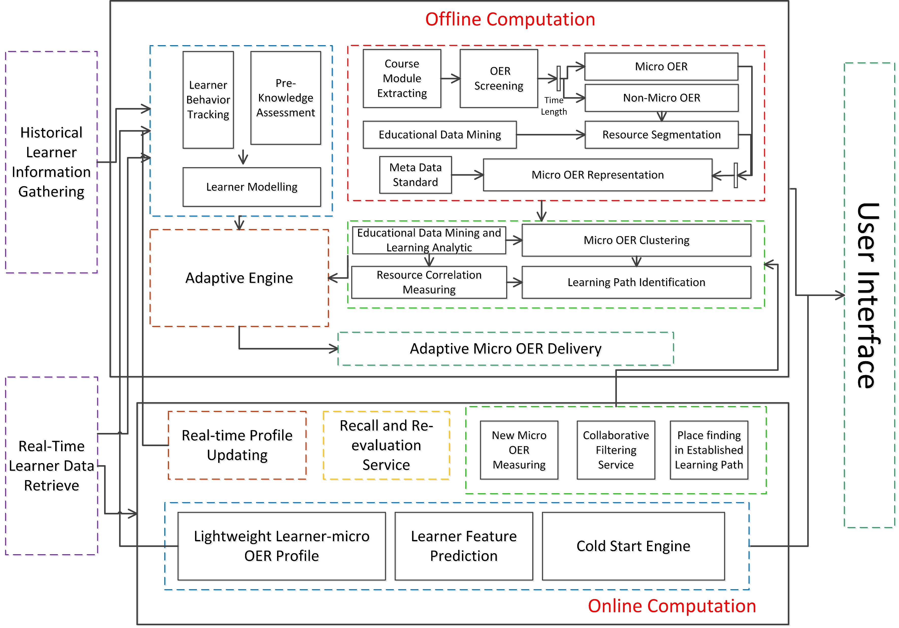
System Framework
Micro Learning as a Service

Slide 10

System Framework
Offline Computation
Big Data on learning
Historical Learning Behaviors

Slide 11
System Framework
Offline Computation
The Adaptive Engine acts on providing learners with customized learning resources matching their current micro learning context, personal demands, learning styles and preference.
The Adaptive process of OER consists of three processes: generating a big map, learning path and recommending specific micro resources for an instant learning.

Slide 12
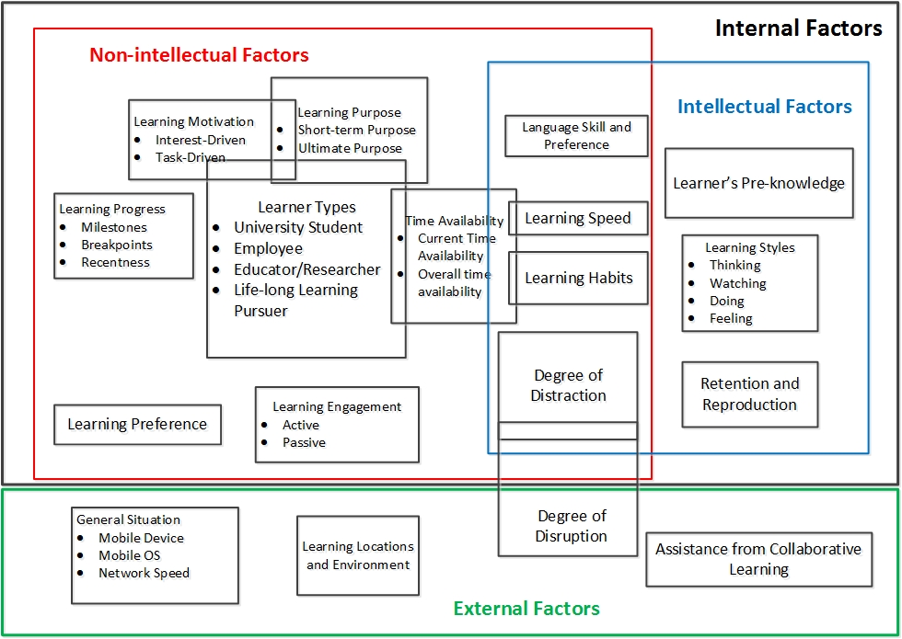
Offline Computation
Comprehensive Learner Model for Micro Open Learning

Slide 13

System Framework
Online Computation
Sparse data
‘Recentness’ of learning behaviors

Slide 14
Offline Computation
Components of Comprehensive Learner Model
Personal Non-Intellectual Factors
Learner Types
Time Availability
Learning Engagement
Progress Identification
Learning Motivation and Purpose
Learning Preference

Slide 15

Offline Computation
Components of Comprehensive Learner Model
Personal Intellectual Factors
Learner Pre-knowledge
Learning Styles
Memory Ability

Slide 16

Offline Computation
Components of Comprehensive Learner Model
Intersection of Non- and Intelligent Factors
Learning Habits
Learning Speed
Language Skill and Preference
Degree of Distraction

Slide 17
Offline Computation
Micro OER Measurement
Non-Functional Attributes:
• Performance (response time, latency, downtime, throughput)
• Reliability (availability, fault tolerance, recoverability)
• Robustness and stability
• Scalability and sustainability
• Compatibility, interoperability and adaptability
• Security

Slide 18
Offline Computation
Components of Comprehensive Learner Model
External Factors
Learning Location and Environment
General Situation
Assistance from Collaborative Learning
Degree of Disruption

Slide 19
EDM and LA
Pattern and Rule Discovery
EDM and LA are jointly carried out over on-campus learning data and open data (big data)
Data sources from UOW data warehouse, potentially Coursera, edX, MITx/HavardX, DART, Canvas

Slide 20
EDM and LA
Pattern and Rule Discovery
Data type | Purpose
logon/out time | To know how long they stay online for each time
The IP address or gateway information of their internet connection | To know their exact learning location and surroundings
Their personal enrollment information | To know their learning time availability， organization， and language skills
Their residential information (session address and permanent address) | To understand their distances to campus and the potential modes of transportation they adopt)
Subjects they chosen (current/historical) | To know their academic background and field
Historical grades | To know their academic background and infer pre-knowledge level
Course materials they have accessed | To know their learning habits (how they prefer the learning resources to be passed on)
  Partial View of Data Sources from On-campus Learning

Slide 21
Offline Computation
Semantic Construction of Learner Model
Conceptual graphs are built to profile micro OERs and learners.
Data come from the explicit data collection (e.g. through mandatory requests) and implicit data tracking (e.g. automatic extraction).

Slide 22
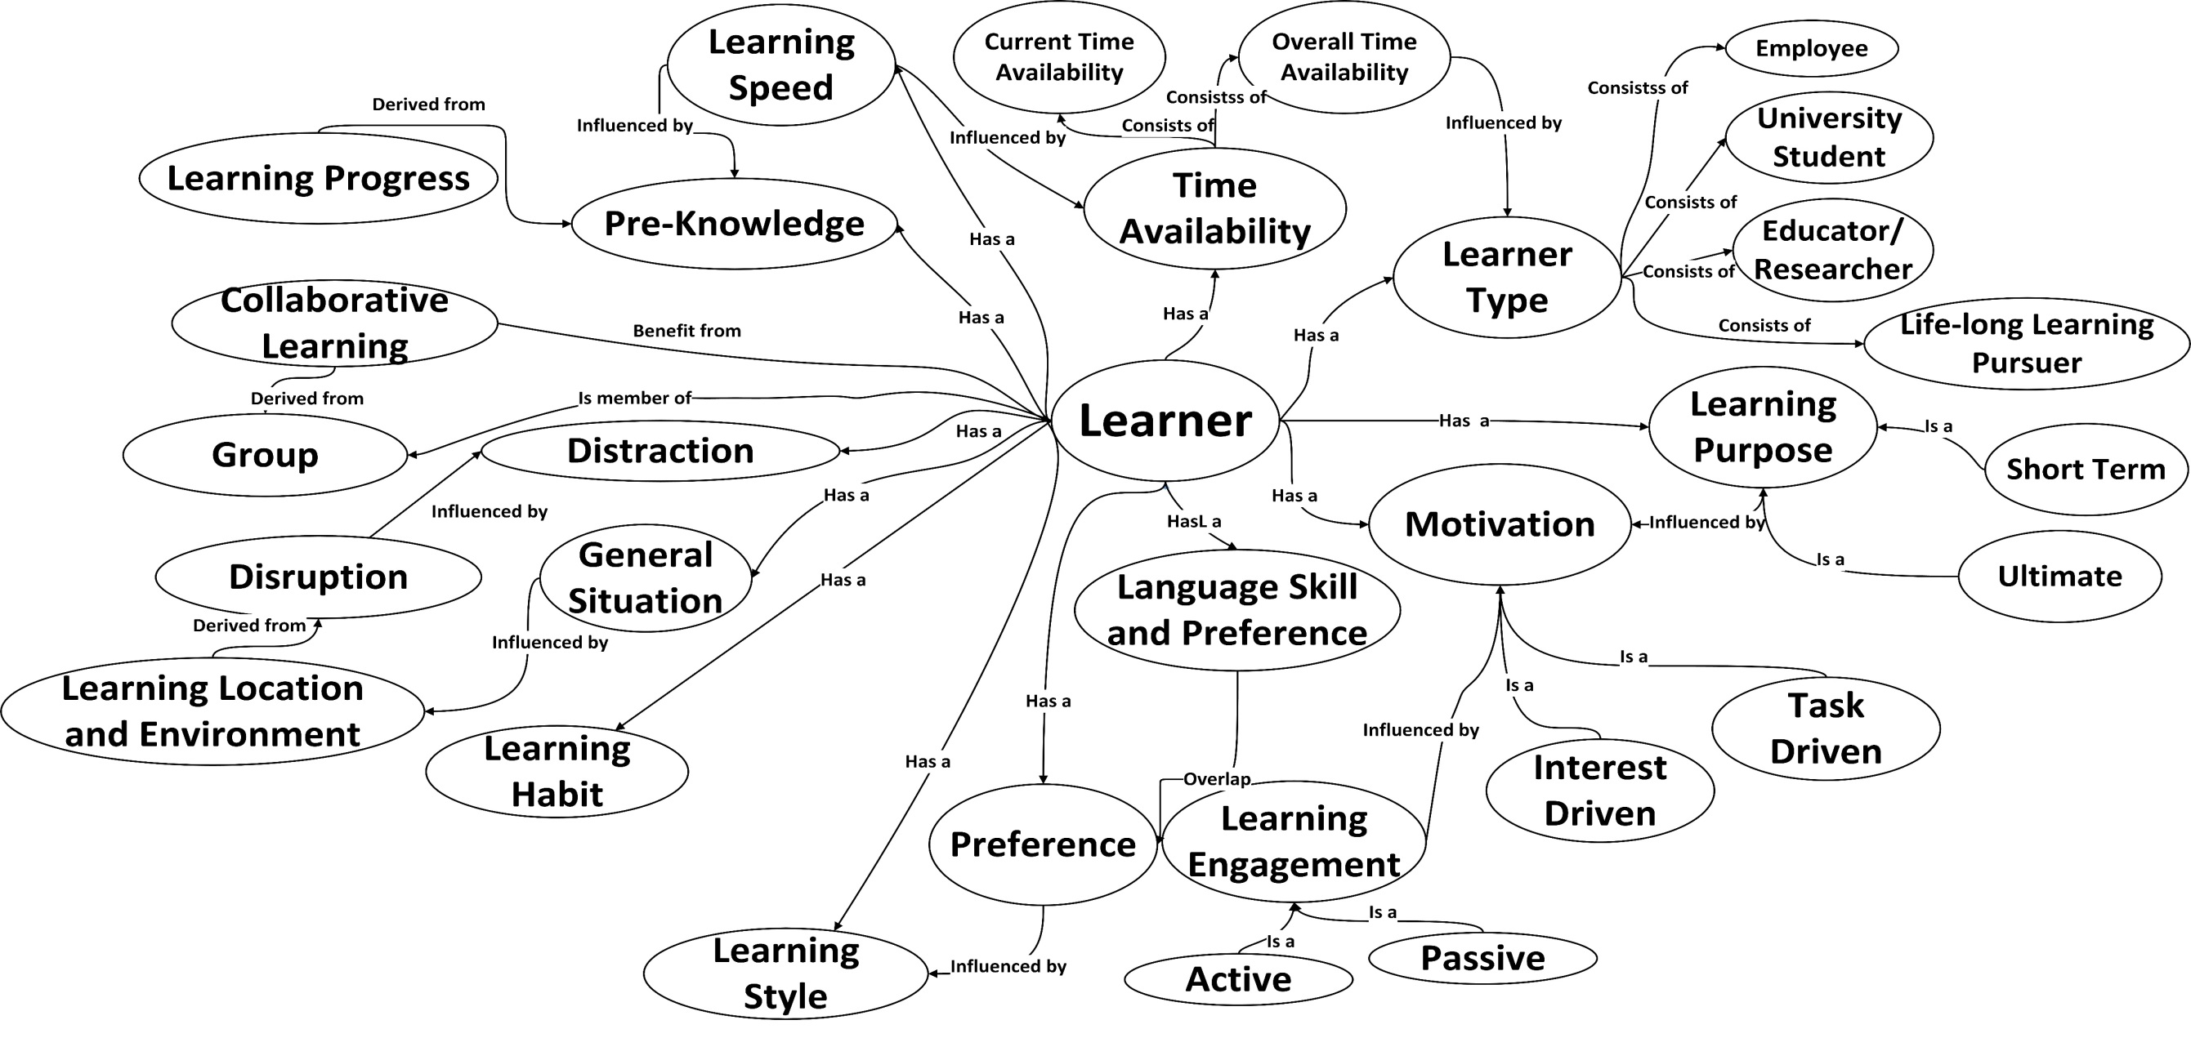
Offline Computation
Semantic Learner Taxonomy for Micro Open Learning

Slide 23
Offline Computation
Semantic Learner Taxonomy for Micro Open Learning
A specific learner profile is a set of nodes in the Benchmark ontology mapping with one node in the OER ontology.
The element Learner is at the center of the graph, surround by annotations in terms of their learning behaviors and context.

Slide 24
Offline Computation
Micro Learning Resources
Micro Learning Resources
Well-established, within 15 mins (or less)
Non-Micro Learning Resources
Need further processing
Visual encyclopedia, logical segmentation of course videos, course-related and educational information in affiliated social media, two-way interactive contents or activity settings

Slide 25
Offline Computation
Micro OER Measurement
Functional Attributes:
• Time length
• Suitability for mobile learning
• Didactic model (inductive, deductive, learning by practice, etc.)
• Mediality (print media, electronic media, mono-media vs. multi-media, (inter-)mediated forms, etc.)
• Difficulty (level of knowledge)
• Completeness

Slide 26
Offline Computation
Micro OER Measurement
Functional Attributes:
• Requirement of attention
• Preferred learning styles
• Type of interaction (expositive, active, one-way imparted or two-way interactive)
• Requirement of input or hands-on practice
• Learning type: repetitive, activist, reflective, pragmatist, conceptionalist, constructivist, connectivist, and behaviorist; also: action learning, classroom learning, corporate learning, etc.
• Basic Information (topic, discipline, serial number, language, etc)

Slide 27
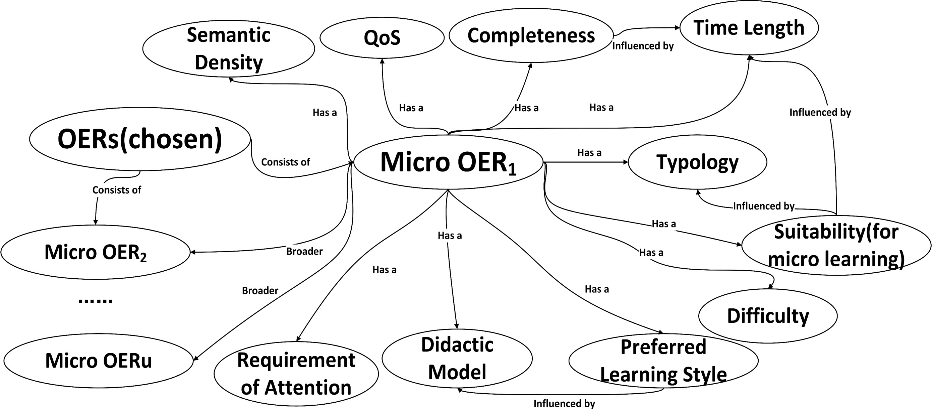
Offline Computation
Conceptual Graph of Augmented Micro OER Ontology

Slide 28
Offline Computation
Educational Data Mining and Learning Analysis
Data source from on-campus and open learning data
OER Investigation
ConsistsOf
RequiredSequence
RecommendedSequence

Slide 29
Online Computation
Cold Start Problem in OER Recommendation
New System: MLaaS (or any other eLearning system either in micro or open way)
New User : learners engaged in micro open learning.
They form as New Communities.

Slide 30
Online Computation
Cold Start Problem in OER Recommendation
Micro open learning activities are on and off frequently.
Learners take part in and deviate from the learning activities frequently.
They switch among courses or resources frequently.

Slide 31
Online Computation
Challenges for cold Start Problem in OER Recommendation
Current learner models on on-campus or mobile learning cannot be directly migrated to micro open learning.
Insufficient data which describe their historical learning behaviors, and even no mature mechanisms to collect such data that can be effective in revealing the entire micro open learning process.

Slide 32

Online Computation
Instant Time Availability
The instant time availability, TA_{j}, is represented by an integer from 1 to 15.
CD(TA_{j}) indicates its confidence degree and CD(TA_{j})= {1/|time span|}

Slide 33
Online Computation
Preference Propagation (upwards)
The preference to a specific micro OER, MR_{u} , acts as the seed.
A spread activation propagates the learners’ seed preferences upwards the hierarchy of micro OER ontology.
Predicted preference P(R_{v}) and its confidence degree CD(R_{v}).
R_{v} is a direct ancestor of MR_{u} .

Slide 34
Online Computation
Distraction Prediction
Demographic Classification
Similarity Measure
in accordance with location similarity
Distraction Prediction
D_{i,Loa} and its confidence degree CD (D)

Slide 35
Online Computation
Integration of Recommendation Results
Downwards propagation (executed with decay factor)
Final preference calculation
for a Learner j’s final preference value regarding Mr_{u} ,
where R is the set of all the nodes in the higher hierarchy than MR_{u}, and Q(u,v) is a function based on the count of level between MR_{u} and R_{v}.

Slide 36
Online Computation
New-user cold start problem
Association Relations among micro OERs
Extracted from available OER and micro OER
For example: ConsistsOf (an inclusion relation)
RequiredSequence (a strong order)
RecommendedSequence (a weak order)

Slide 37
Online Computation
New-user cold start problem
Rules of generating recommendation list of micro OERs
Executed with priority
Provided a RequiredSequence relation, the prerequisite one is placed first.
Provided P_{u,j} >P_{w,j}, then the MR_{u} is prior to MR_{w}
Provided CD(P_{u，j}) is high and the CD(P_{w,j}) is low (in absolute terms), then the MR_{u} is prior to MR_{w}.
Provided a RecommendedSequence relation, the one which is suggested to be accessed first is placed first.
The micro OER more related to the learner’s knowledge background is placed first
The micro OER falls in the relevant disciplines or inter-disciplines is placed with priority if the disciplinary difference between this two candidate micro OERs is obvious and neither is directly related to the learner’s knowledge background.
Otherwise the recommended micro OER list is randomly ordered if none of the above rules applies.

Slide 38
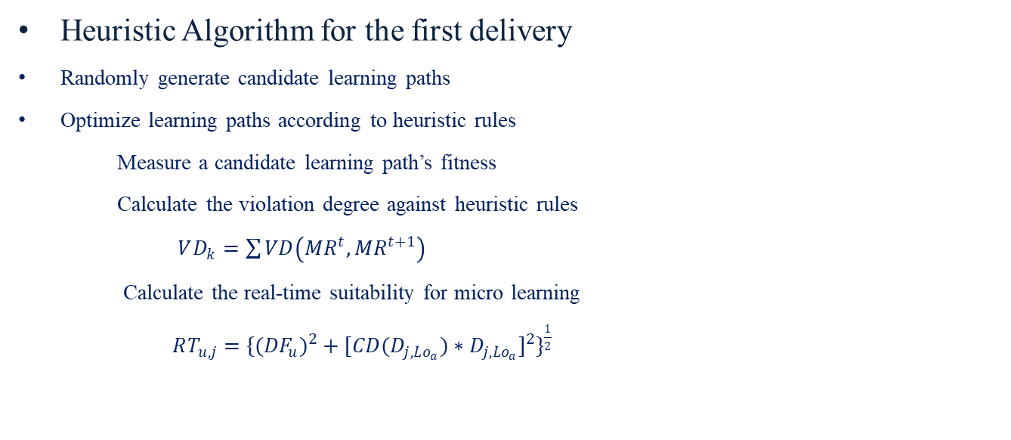
Online Computation
New-user cold start problem
Heuristic Algorithm for the first delivery
Randomly generate candidate learning paths
Optimize learning paths according to heuristic rules
Measure a candidate learning path’s fitness
Calculate the violation degree against heuristic rules
$VD_{k}=\sum{VD\left(MR^{t},MR^{t+1}\right)}$
Calculate the real-time suitability for micro learning
$RT_{u,j}=\{({DF}_{u})^{2}+[CD(D_{j,Lo_{a}})∗D_{j,Lo_{a}}]^{2}\}^{\frac{1}{2}}$

Slide 39

Online Computation
New-user cold start problem
Heuristic Algorithm for the first delivery
Fitness function
$$η=\min{(}αVD_{k}+β/RT_{k,j}+γ/P_{k,j}^{1}+δ/P_{k,j})$$
minimize violation degree
while maximize real-time suitability micro learning and particular preferences

Slide 40

Online Computation
New-user cold start problem
Heuristic Algorithm for the first delivery
Output selected N learning paths after heuristic operation
Select the first micro OER in each selected learning path as the first delivery
(This can explain why the particular preference to the first micro OER in a learning path $P_{k,j}^{1}$ is maximized according to the fitness function )

Slide 41
Online Computation
Integration of Recommendation Results (Cold Start Problem)
Rule based Optimization
Heuristic algorithm for the first delivery
Minimize the violation degree in a candidate learning path
Select the first OER in each of the top N learning paths
It can be referred to SCC paper: G. Sun, T. Cui, D. Xu, H. Chen, S. Chen and J. Shen, ‘Assisting Open Education Resource Providers and Instructors to Deal with Cold Start Problem in Adaptive Micro Learning: a Service Oriented Solution’, the 14th IEEE International Conference on Services Computing (SCC), Hawaii, USA, June 2017.

Slide 42
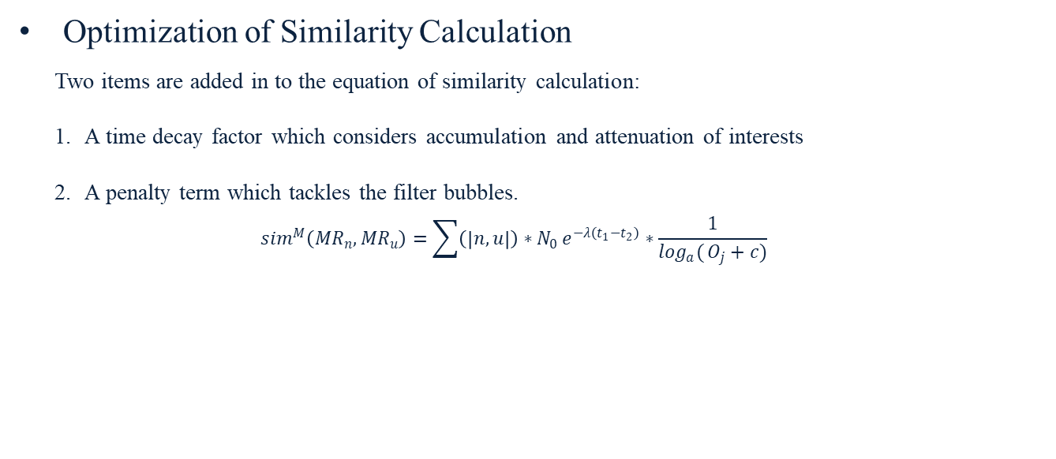
Online Computation
New-item cold start problem
Optimization of Similarity Calculation
Two items are added in to the equation of similarity calculation:
A time decay factor which considers accumulation and attenuation of interests
A penalty term which tackles the filter bubbles.
$$sim^{M}\left({MR}_{n}, {MR}_{u}\right)=\sum{\left(\left|n,u\right|\right)∗N_{0}}e^{−λ\left(t_{1}−t_{2}\right)}∗\frac{1}{\log_{a}{(}O_{j}+c)}$$

Slide 43
Online Computation
New-item cold start problem
Measure a newly published micro OER, MR_{n} ’s similarities with existing micro OERs
Use kNN to cluster MR_{n} ’s neighbors (Let G denote the set of neighbors)
Prediction of a learner’s preference to a newly published micro OER

Slide 44
Online Computation
New-item cold start problem
Algorithm to insert new micro OER into established learning path
Investigate the new micro OER MR_{n} in terms of association relations as pre-defined
Measure its similarities with existing micro OERs
Use kNN to obtain its neighbours
Produce learning paths
Select learning paths containing MR_{n} ’s neighbors (where MR_{g} ∈ G)
Find rough segments containing MR_{g}

Slide 45
Online Computation
Cold start problem
Algorithm to insert new micro OER into established learning path
Place MR_{n} in each selected segment according to pre-defined association relations
Measure fitness of the new learning path with MR_{n} inserted (using same fitness function)
Replace an existing micro OER in established learning path with worse fitness
or
Insert MR_{n} between 2 existing micro OERs, keep it added on (the length of learning path increases)
Output optimized new learning path with MR_{n} inserted
Detailed Algorithm can be referred to: G. Sun, T. Cui, G. Beydoun, S. Chen, D. Xu and J. Shen, ‘Organizing Online Computation for Adaptive Micro Open Education Resource Recommendation’, the 16th International Conference on Web-based Learning (ICWL), Cape Town, South Africa, September 2017, pp. 177-182.

Slide 46
Online Computation
New-item cold start problem
Optimization of Similarity Calculation
Segmentation of Learning Path Containing Approximate Orders
Sequence Measurement
Insert a new OER into a Established Learning Path
Detailed Algorithm can be referred to: G. Sun, T. Cui, D. Xu, S. Chen and J. Shen, ‘A Heuristic Approach for New-item Cold Start Problem in Recommendation of Micro Open Education Resources’, the 14th International Conference on Intelligent Tutoring Systems (ITS), Montreal, Canada, June 2018, pp.212-222.

Slide 47
Evaluation
Empirical study 1- new-user cold start
OERs are collected from main providers and their DF values are measured.
Five Grade Levels: Primary, Secondary, Further Education (diploma, college and technical schools), Higher Education (undergraduate) and Postgraduate.
Four Level of study: Introductory Unit, an Intermediate Unit or Principal Area of Study, an Advanced Unit and a Specialized Advanced Unit.

Slide 48
Evaluation
Empirical study 1- new-user cold start
Genetic Algorithm, simulated annealing, Tabu search and evolutionary programming are utilized.
Scale of relevant micro OERs are generated through numerous operations of Algorithm with different setting of N value.
Recall and Precision values are selected as the main indices of evaluation.

Slide 49
Evaluation
Empirical Study 1-New-user cold start problem
Precision of Top N Recommendations by Heuristic Algorithms Recommendation
Recall of Top N Recommendations by Heuristic Algorithms

Slide 50
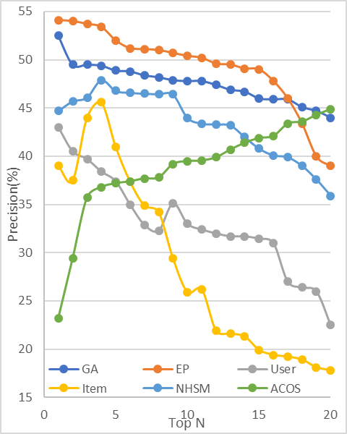
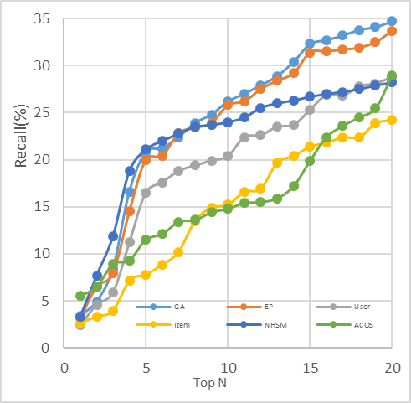
Evaluation
Empirical Study 2-Comparison of Recommenders
Precision Values of Top N Results by Different Recommenders
Recall Values of Top N Results by Different Recommenders

Slide 51
Evaluation
Empirical study 3- new-item cold start
Micro OERs in IT, business and social science fields are evaluated.
Comparison with shortest-path approach and competency-based approach.
Violation Degrees are compared.

Slide 52
Evaluation
Empirical study 3- new-item cold start
Performance Comparison – Average VDs of All Generated Learning Paths
Performance Comparison – Average VDs of the Best Learning Paths for Each Test Micro OER

Slide 53
Proteomics
In our second area of research, proteomics is a main focus
  protein is the basis of living organisms
  interactions between different proteins are the basis of the biological functions
  specifically in our research, we aims at host-bacterium protein-protein interactions (HB-PPI)

Slide 55
Proteomics
The Status
  Data format: HUPO PSI-MI XML and MITAB2.5
  Data curation strategy: how to design a strategy to aligh the world wide databases to a same identifier with both original resource and shattered distributions
  Data service: PSICQUIC
  Data analysis: a long-term goal

Slide 56
Details can be referred to: Chen, H., Shen, J., Wang, L., Song, J. & Chi, C., 2018, “Towards Biological Sequence Data Service with Insights”, Proceedings of IEEE International Conference on Big Data, 2018, pp. 2847–2854

Slide 57
Proteomics
Start Point
  HP-PPI research initialized as a strategic plan by the National Institute of Allergy and Infectious Diseases (NIAID)
  Focusing on biodefense research to define a 'Priority Pathogens'
  Several databases are subsequently developed wholloy or partially funded by NIAID
    Pathogen interaction gateway, BioHealthBase, The Pathosystems Resource Integration Center
    The Virus Pathogen Database and Analysis Resource, VectorBase
  Carefully filtered and manually examined the ‘abstract' from a first 400 literature results ranking by best relevance out of more than 4,000 returning items, which were searched by NCBI PubMed search engine with keywords 'pathogen' and 'database'
Details are under the preparation of submission for BIB journal: Chen, H., Shen, J., Wang, L., Song, J. & Chi, C., 2019, “A Comprehensive Overview of Host-Pathogen Interactions Resources”, Briefing in Bioinformatics, 1-12

Slide 58
Proteomics
Statistic analysis
  A broad investigation of published databases
  Statistic reports regarding HP-PPI
  We firstly collected the data
    DIP, Reactome, APID, IntAct, MINT, InnateDB, PHISTO, PATRIC, Mentha, HPIDB and BioGRID
    up-to-date data were collected
    Host species are mostly limited within several species, we chose to work on Homo sapiens (taxonomy ID: 9606) as the subject
Notes:
PHPPI data, especially for the experimentally verified ones, is critical for the model learning and prediction performance. These are positive PHPPI data set
For negative PHPPI data set, we need to collect the related proteins information from Uniprot first and randomly pair them.

Slide 59
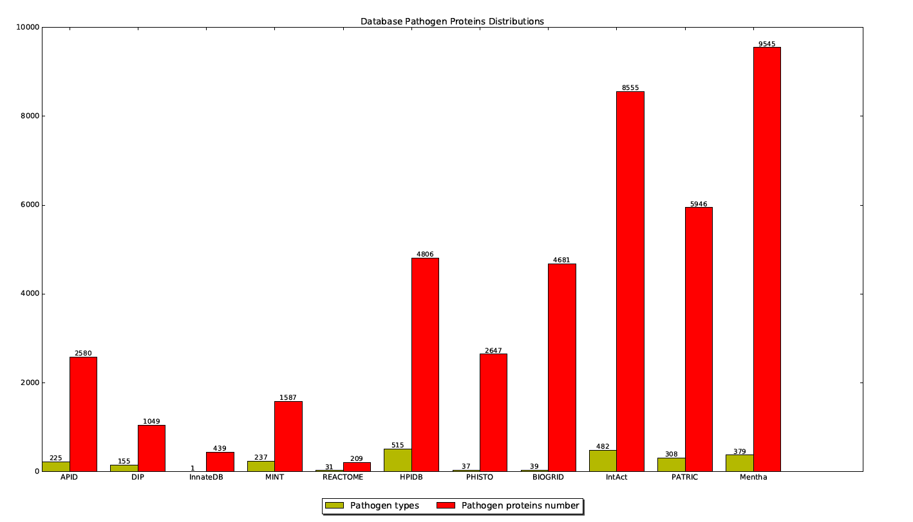
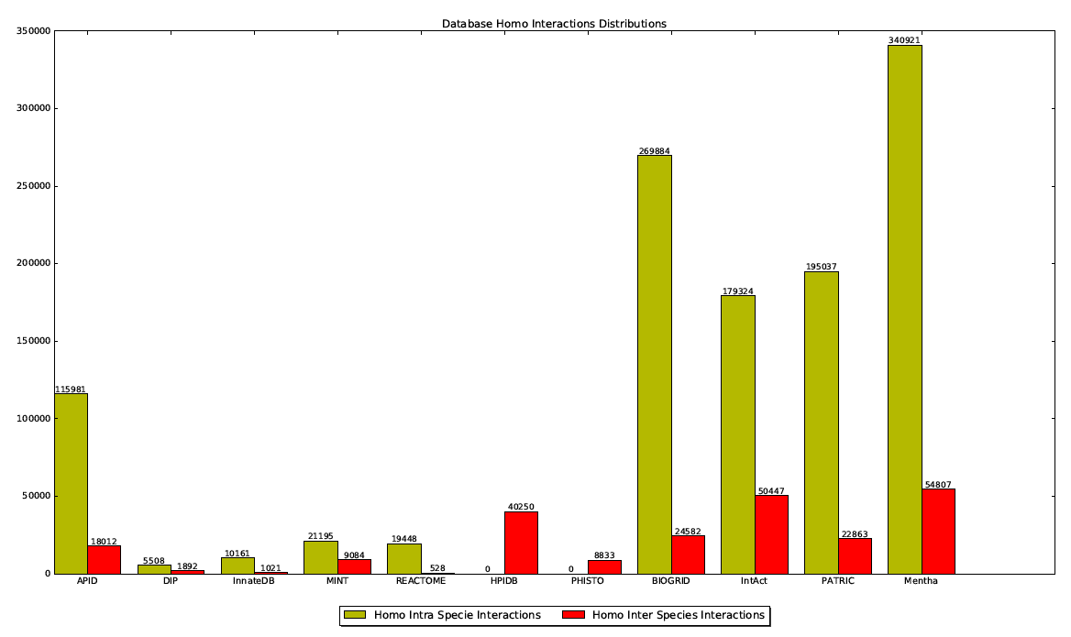
Proteomics

Slide 60
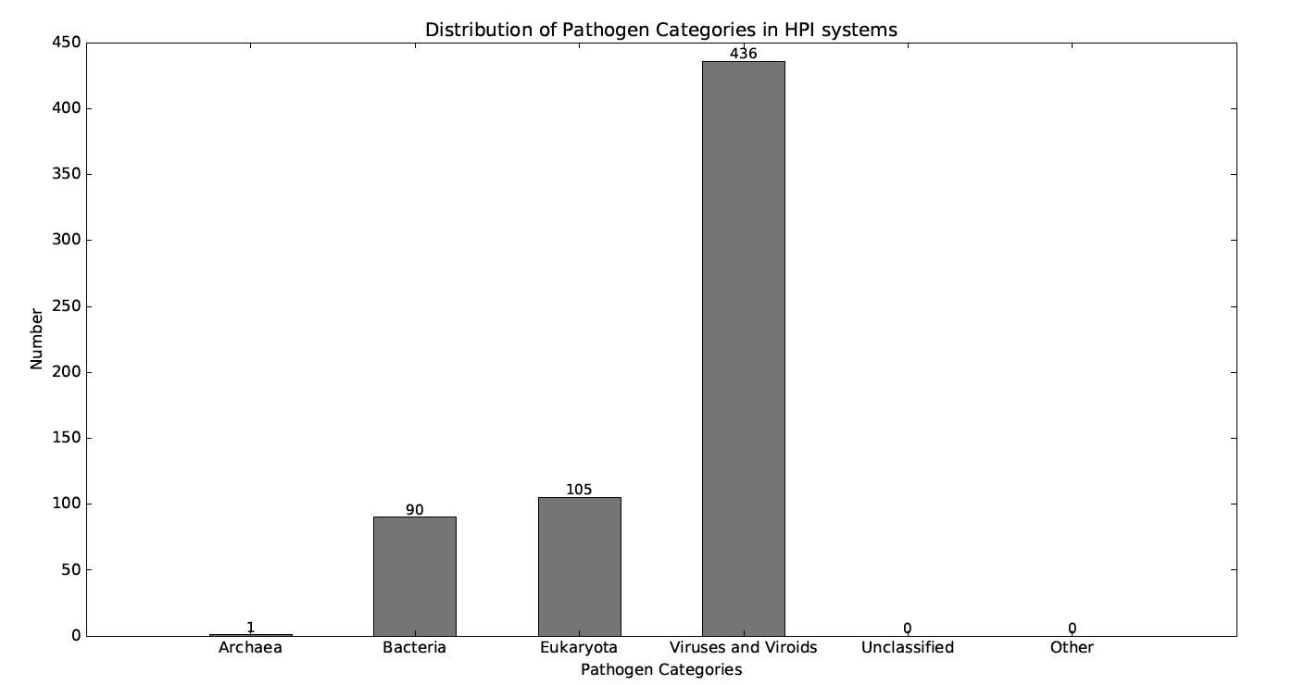
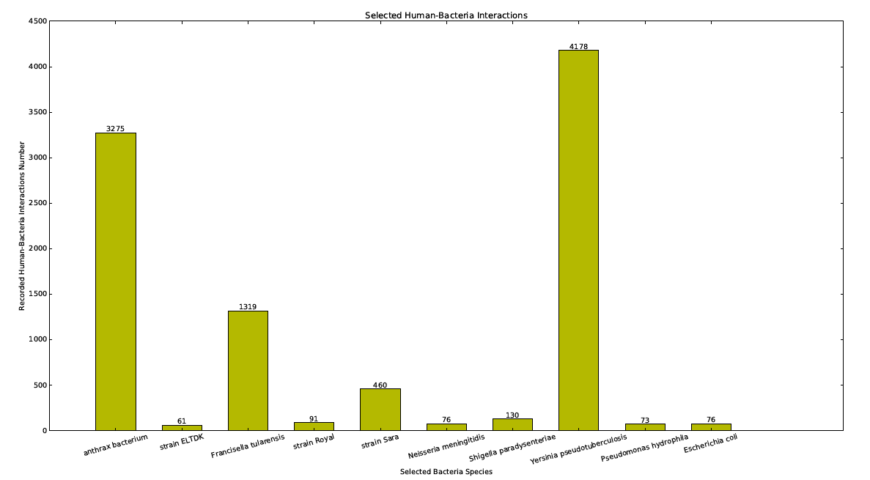
Proteomics
Notes:
This figure indiscates the specific categories of pathogens in HPI systems.

Slide 61
Proteomics
Bioinformatics approaches for HPI study
  Template-based Prediction
  Machine learning based Prediction
  We chost to work on Human-Bacterium protein-protein interactions
  Focus on sequence-based prediction
Notes:
For the HPI, or HBI study in our work, mainly there are two kinds of bioinformatics approaches for the prediction.

Slide 62
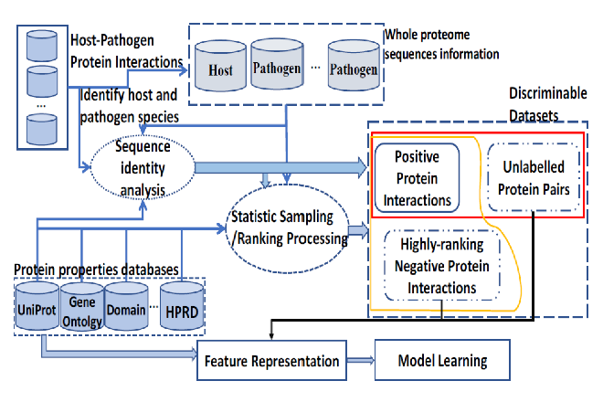
Proteomics
Chen, H., Shen, J., Wang, L. & Song, J., 2018, “A Framework towards Data Analytics on Host-Pathogen Protein-Protein Interactions”, Journal of Ambient Intelligence & Humanized Computing.

Slide 63
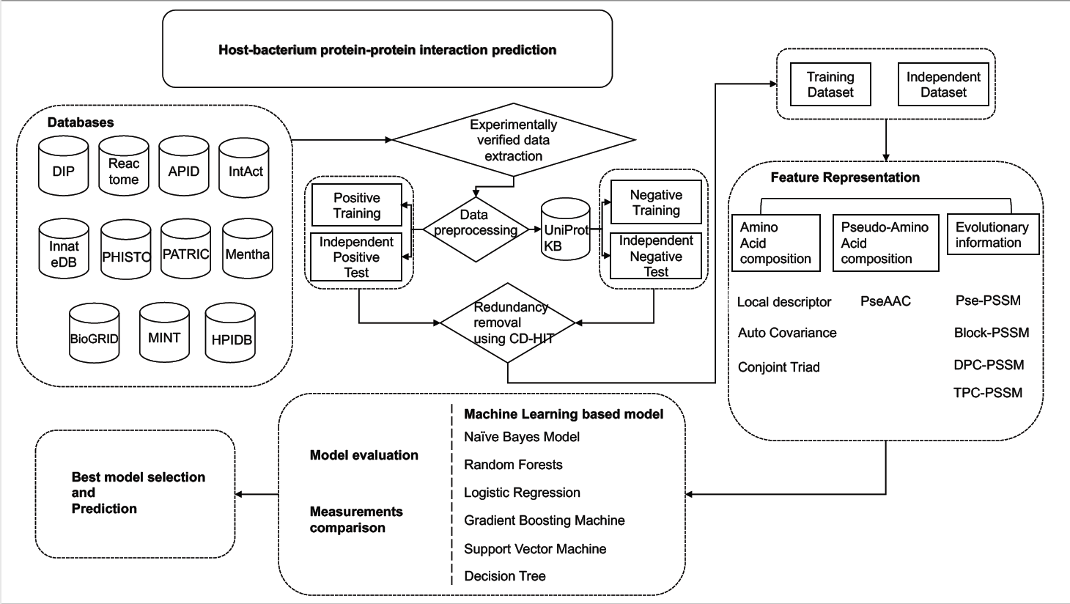
Proteomics
The Detailed Framework
Chen, H., Shen, J., Wang, L., Song, J. & Chi, C., 2019, “Systematic Evaluation of Sequence-based Machine Learning Prediction Models for Human-Bacterium Protein-Protein interactions”, prepared for Briefing in Bioinformatics, 1-20

Slide 64
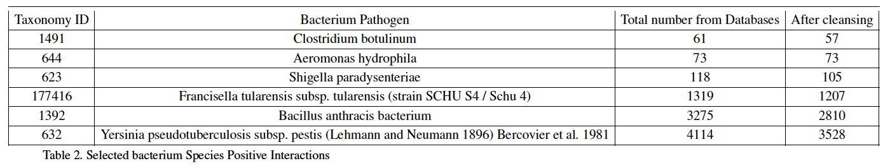
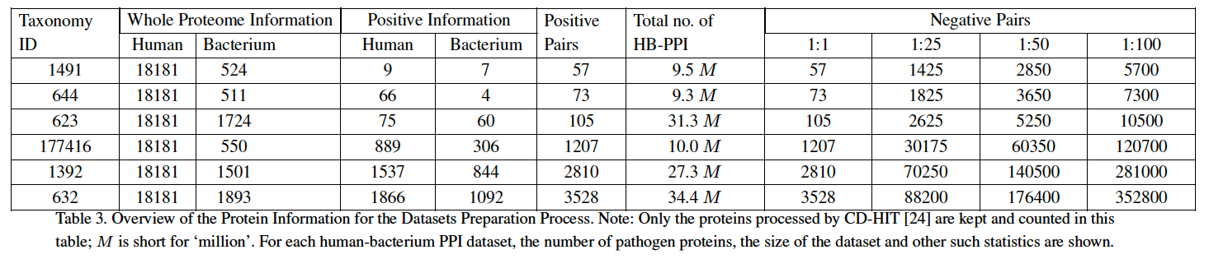
Human-Bacterium PPI
Bacteria Selected:
Datasets:

Slide 65
Human-Bacterium Protein-protein Interactions
We also surveyed the traditional machine learning models
  Random Forest
  Support Vector Machine
  Logistics regression
  Decision tree
  Naive Baye Model
  Gradient Boosting Machine

Slide 66
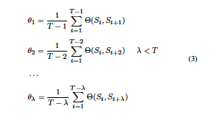
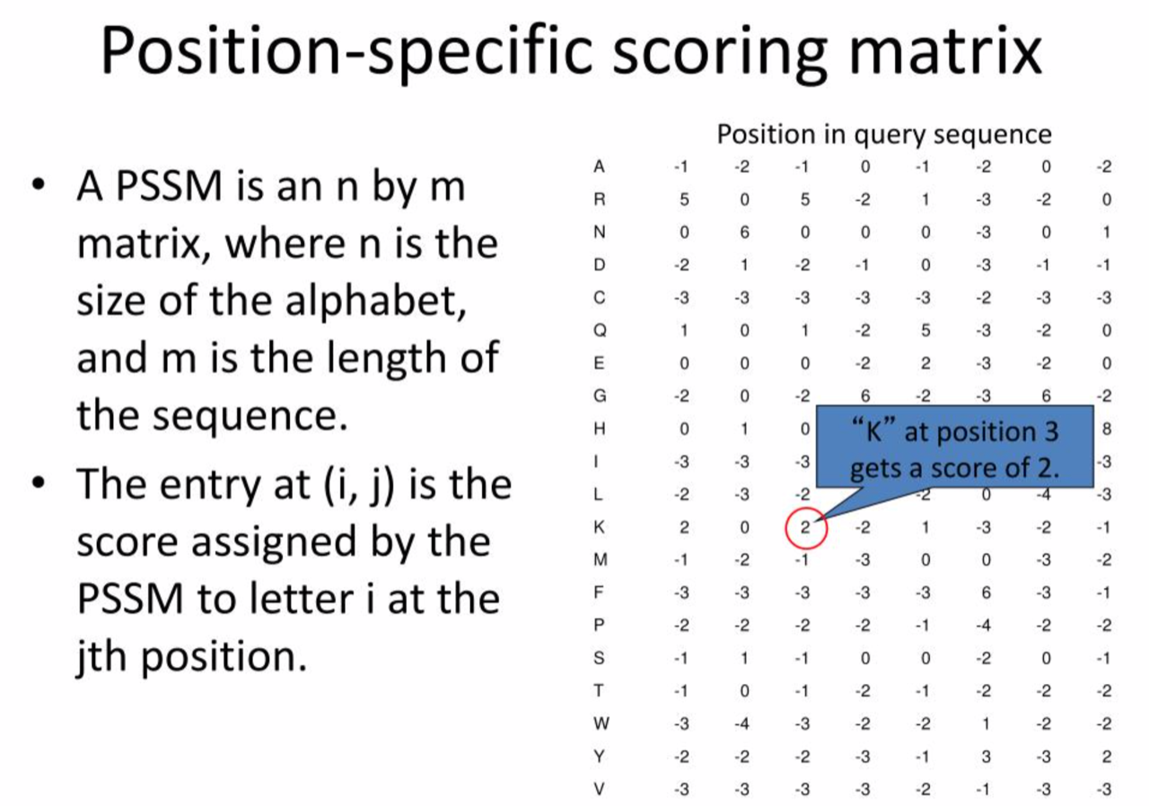
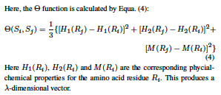
Human-Bacterium Protein-protein Interactions
We also included different feature representation algorithgms
  Conjoint triad method
  Auto covariance
  Local descriptor
  Pseudo-amino acid composition
  Pseudo-PSSM
  DPC-PSSM
  Block-PSSM

Slide 67
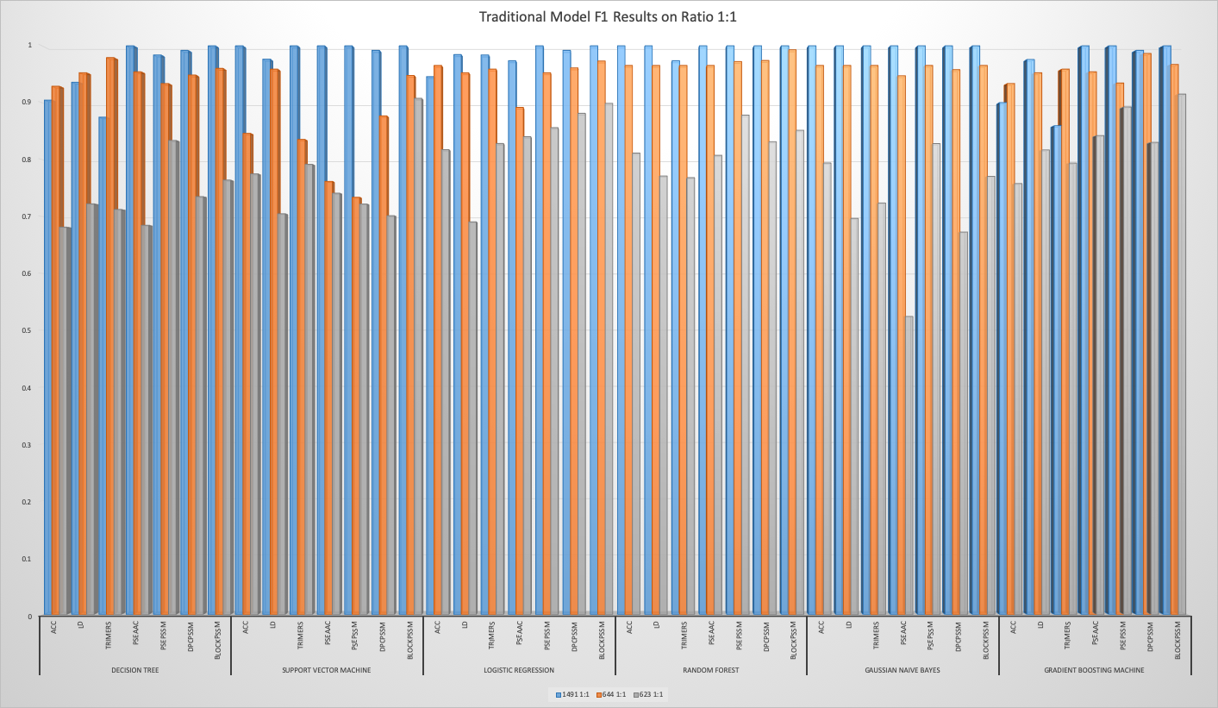
Human-Bacterium Protein-protein Interactions
F1 results collected from ratio 1:1

Slide 68
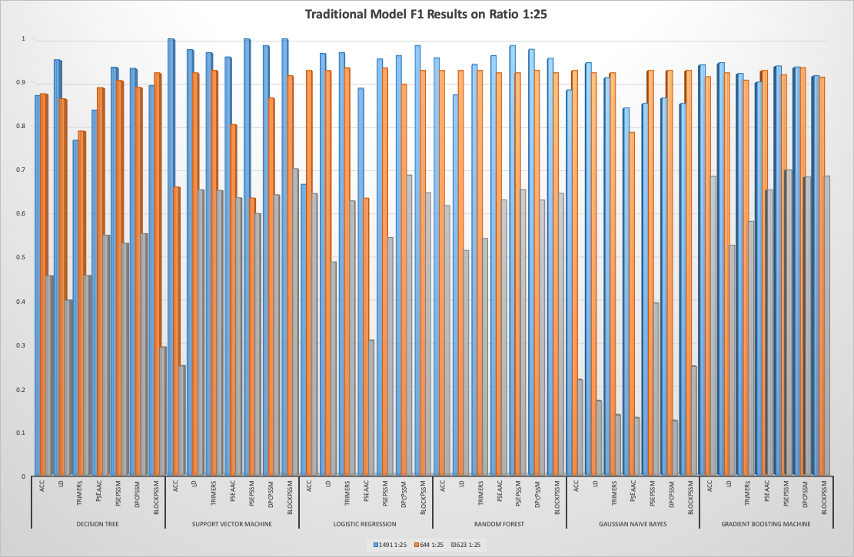
Human-Bacterium Protein-protein Interactions
F1 results collected from ratio 1:25

Slide 69
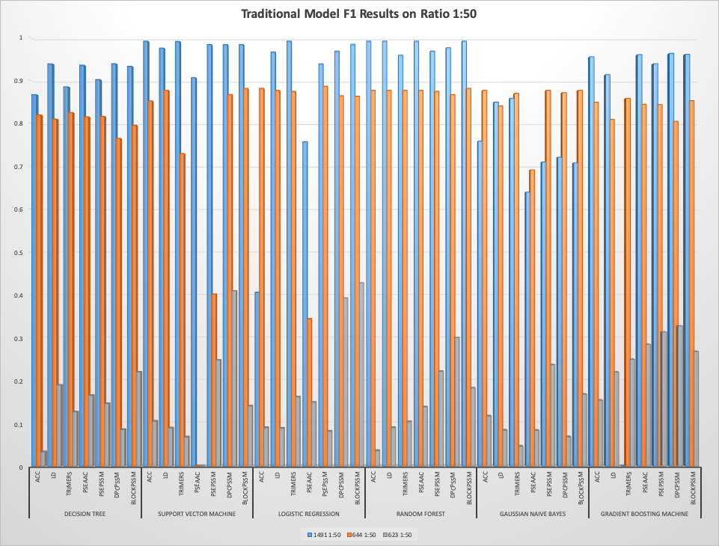
Human-Bacterium Protein-protein Interactions
F1 results collected from ratio 1:50

Slide 70
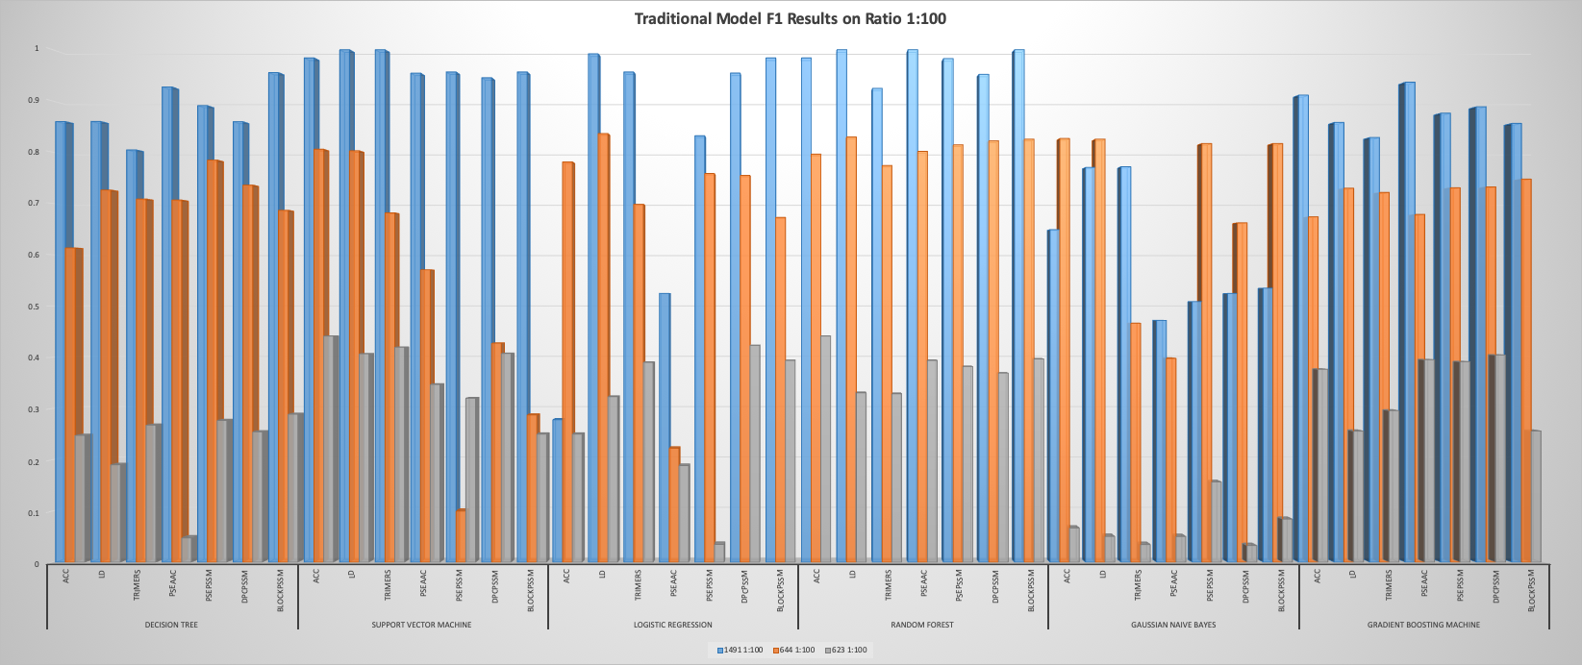
Human-Bacterium Protein-protein Interactions
F1 results collected from ratio 1:100

Slide 71
Human-Bacterium PPI
F1 results collected from ratio 1:1

Slide 72
Human-Bacterium PPI
F1 results collected from ratio 1:25

Slide 73
Human-Bacterium PPI
F1 results collected from ratio 1:50

Slide 74
Human-Bacterium PPI
F1 results collected from ratio 1:100

Slide 75
Human-Bacterium PPI
Accuracy results collected from ratio 1:1

Slide 76
Human-Bacterium PPI
Accuracy results collected from ratio 1:25

Slide 77
Human-Bacterium Protein-protein Interactions
Accuracy results collected from ratio 1:50

Slide 78
Human-Bacterium PPI
Accuracy results collected from ratio 1:100

Slide 79
Human-Bacterium Protein-Protein Structures
Chen, H., Guo, W., Shen, J., Wang, L. & Song, J., 2018, “ Structural Principles Analysis of Host-Pathogen Protein-Protein Interactions: A Structural Bioinformatics Survey”, IEEE Access, 6:11760-11771.

Slide 80
Intelligent Transport Systems
Seamless multimodal journeys
A single user interface
The accessibility of dynamic transportation services for everyone

Slide 81
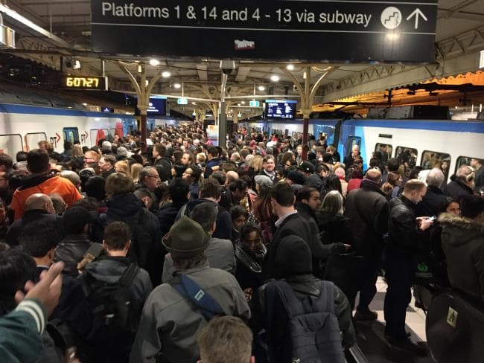
Predict Traffic Status for Mobility as a Service
Source: Herald Sun, July 13, 2017
Melbourne Metro trains delay due to infrastructure fault

Slide 82

Missed the Train
Source: https://outside-jane.blogspot.com

Slide 83
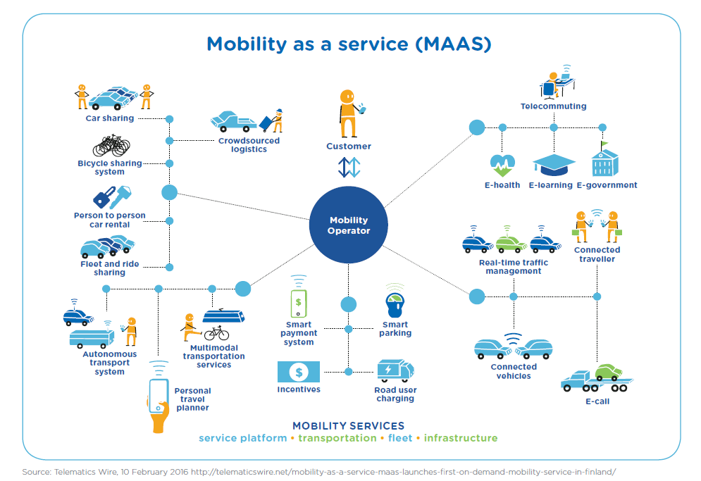
Mobility as a Service
Detailed explanation can be referred to: J. Wu, L. Zhou, C. Cai, J. Shen, S. K. Lau and J. Yong, "Data Fusion for MaaS: Opportunities and Challenges," 2018 International Conference on Computer Supported Cooperative Work in Design (CSCWD),

Slide 84
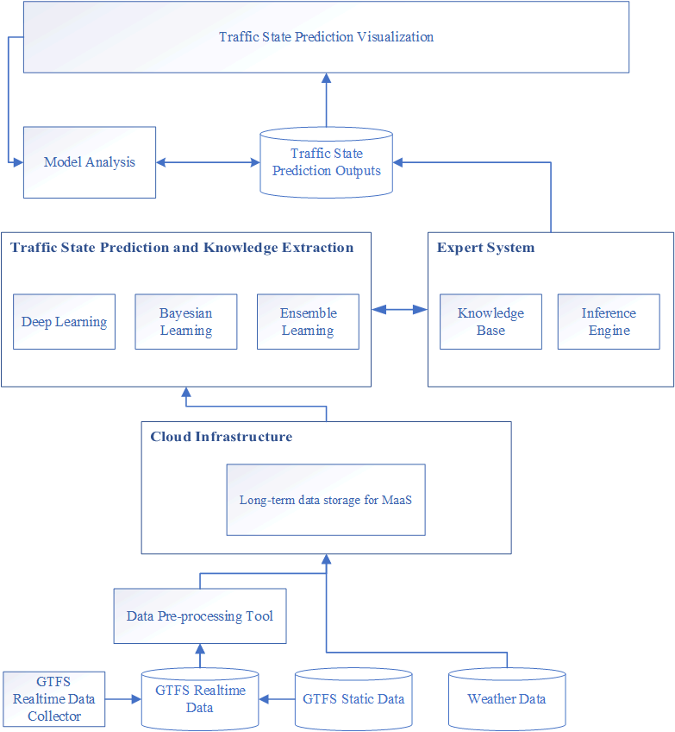
The Big Picture
Towards a General Prediction System for the Primary Delay in Urban Railways (accepted by IEEE ITSC)

Slide 85
Data Availability
General Transit Feed Specification (GTFS) was developed in 2005 by Google and TriMet for transit agencies to publish detailed transit schedules in an open data format.
GTFS and GTFS real-time specification enable transit agencies and operators to exchange both static and real-time public transit information

Slide 86
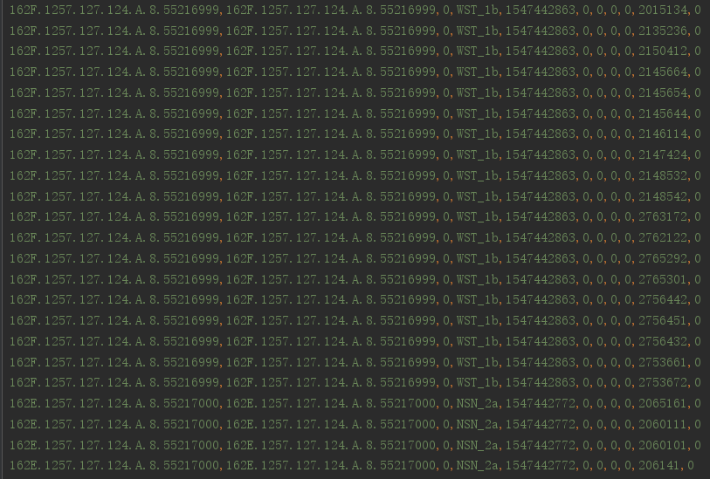
GTFS-Realtime Raw Data
The raw data with the frequency range of 10 to 30 sec from real-time GTFS
For example, collecting GTFS trip updates of Sydney Trains with a 10-sec frequency can generate a dataset between 2 and 4 GB
Can be preprocessed into a data set between approximately 3 and 6 MB dataset.
Used for train delay prediction,

Slide 87
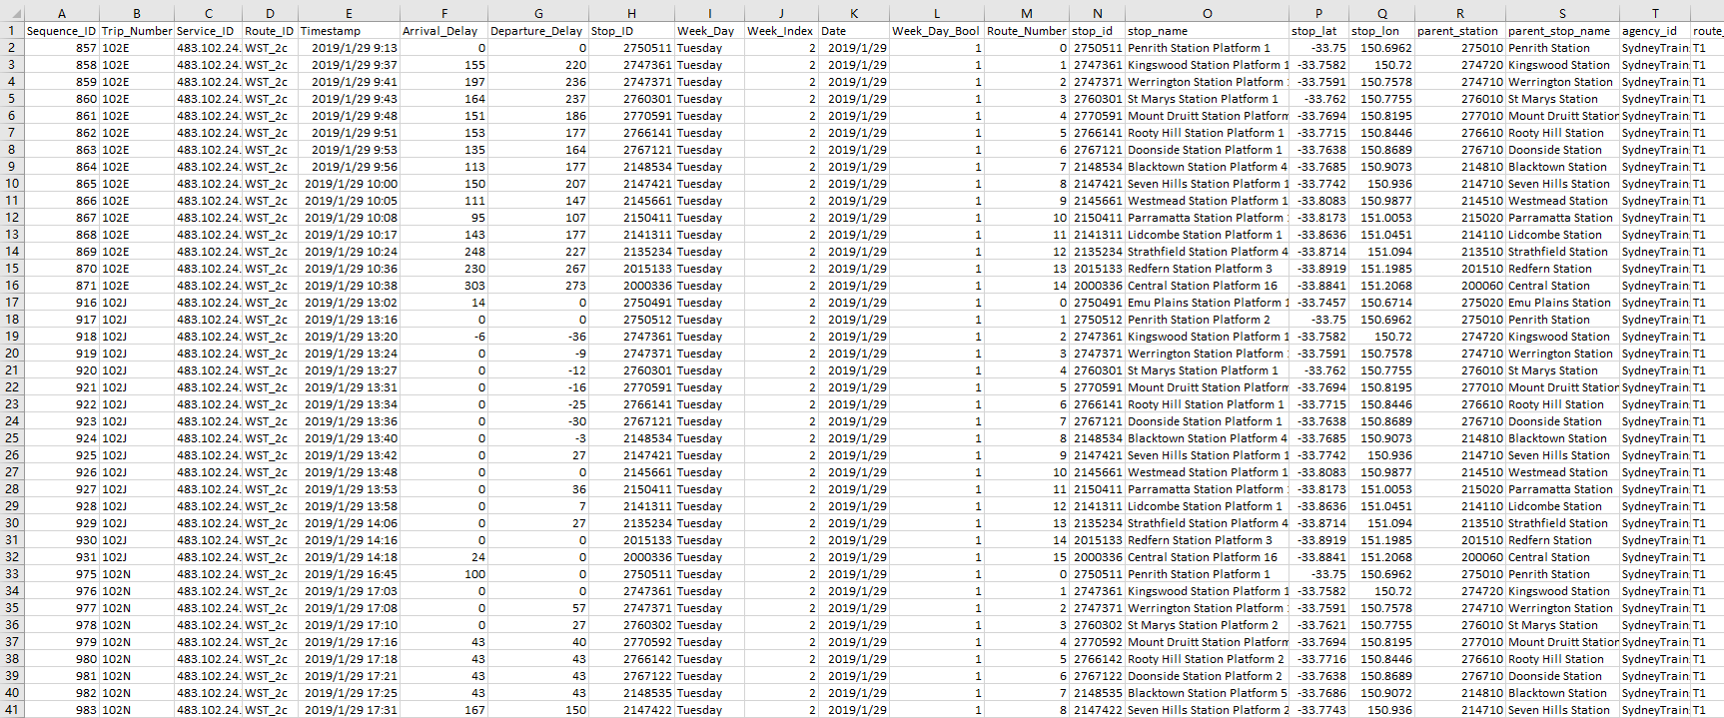
Customising GTFS Dataset for Sequence Learning

Slide 88
Sum of Train Delay

Slide 89
Daily Average Delay (sec)
Daily average delay (sec)

Slide 90
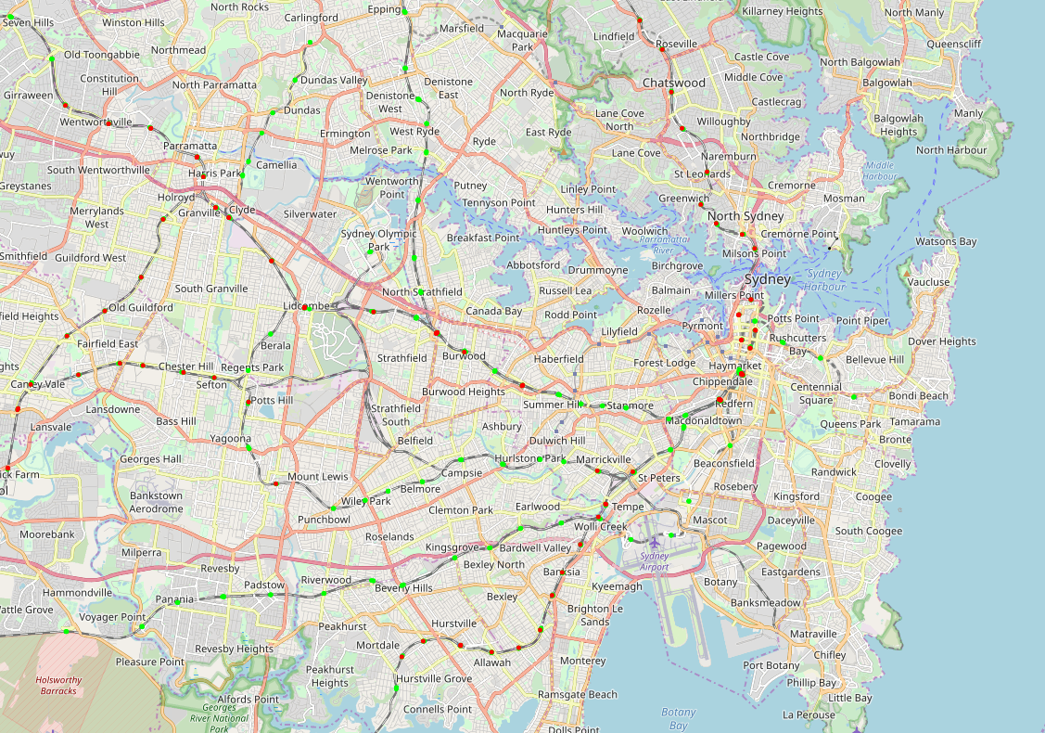
Plotting the Data into OpenStreetMap after Predictions

Slide 91
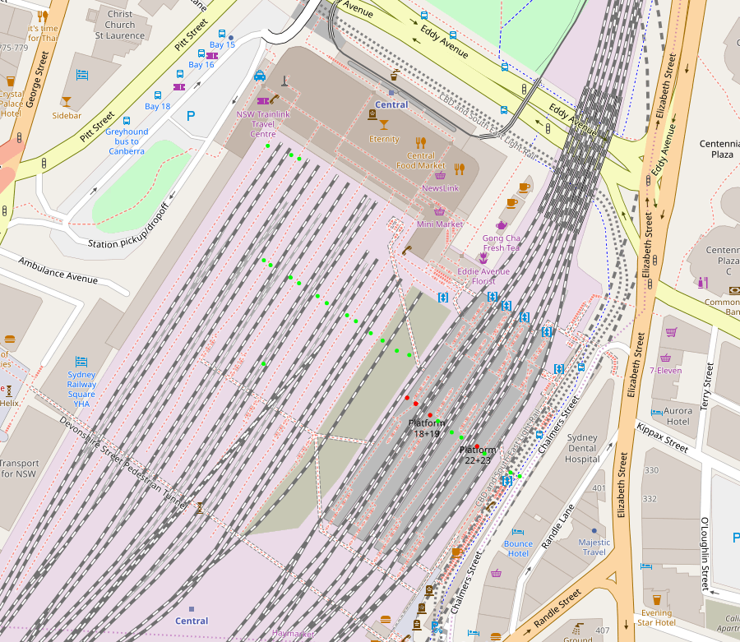
Plotting the Data into OpenStreetMap after Predictions

Slide 92
Why LSTM?
Long Short-Term Memory (LSTM) is able to solve many time series tasks unsolvable by feedforward networks using fixed size time windows
It has the ability to capture local information of each segment and the long term correlation in a sequence, and obviate the need for a pre-specified time window and are able to model complex multivariate sequences accurately
ConvLSTM does not have negative number predictions by using linear activation function at each of ConvLSTM layers and Rectified Linear Unit (ReLU) activation function at the fully connected (FC) layer, it is a vital for delay forecast models to predict positive times .

Slide 93
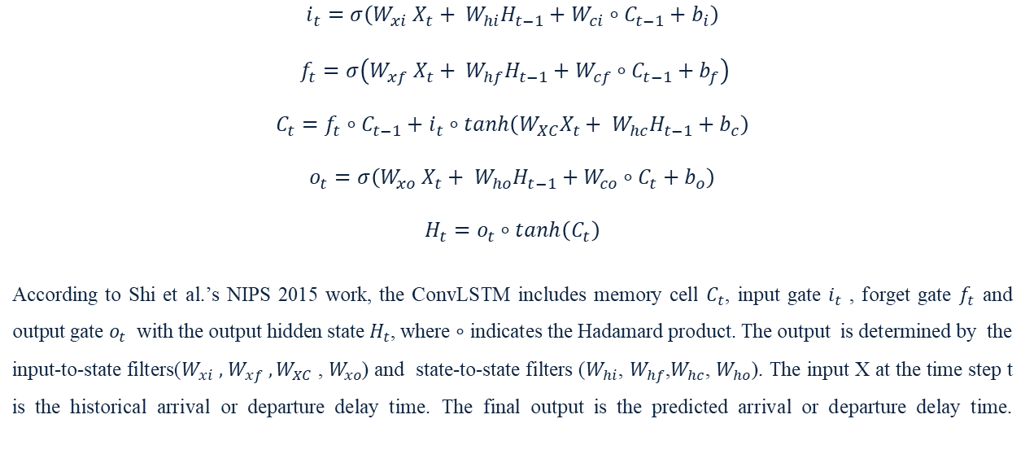
Convolutional LSTM Spatiotemporal Correlations for Sequence Learning
$$i_{t}=σ\left(W_{xi} X_{t}+ W_{hi}H_{t−1}+W_{ci}∘C_{t−1}+b_{i}\right)$$
$f_{t}=σ\left(W_{xf} X_{t}+ W_{hf}H_{t−1}+W_{cf}∘C_{t−1}+b_{f}\right)$
$$C_{t}=f_{t}∘C_{t−1}+i_{t}∘tanh（W_{XC}X_{t}+ W_{hc}H_{t−1}+b_{c}）$$
$$o_{t}=σ\left(W_{xo} X_{t}+ W_{ho}H_{t−1}+W_{co}∘C_{t}+b_{o}\right)$$
$$H_{t}=o_{t}∘tanh（C_{t}）$$
According to Shi et al.’s NIPS 2015 work, the ConvLSTM includes memory cell $C_{t}$, input gate $i_{t}$ , forget gate $f_{t}$ and output gate $o_{t}$ with the output hidden state $H_{t}$, where $∘$ indicates the Hadamard product. The output is determined by the input-to-state filters($W_{xi} ,$ $W_{xf} ,W_{XC}$ , $W_{xo}$) and state-to-state filters ($W_{hi}$, $W_{hf}$,$W_{hc}$, $W_{ho}$). The input X at the time step t is the historical arrival or departure delay time. The final output is the predicted arrival or departure delay time.

Slide 94
Better Prediction
Repeated evaluation on the mean and standard deviation of model performance
To combine with AI/ES system
An Expert System includes Knowledge base, Inference Engine and User Interface.
An Inference Engine mainly contains two modes: forward chaining and backward chaining algorithms

Slide 95
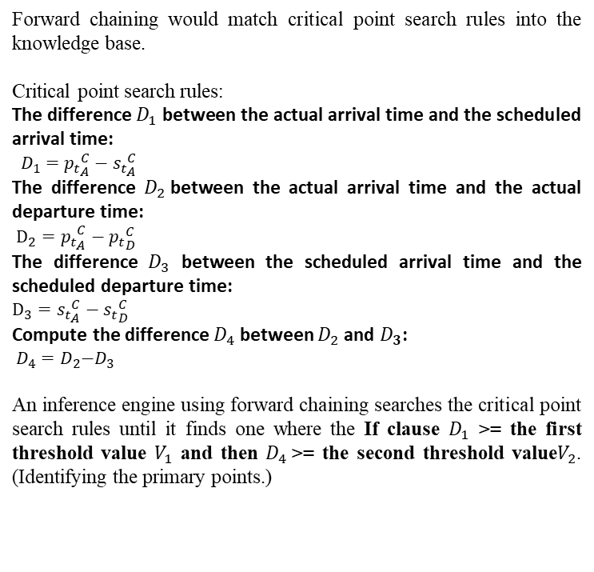
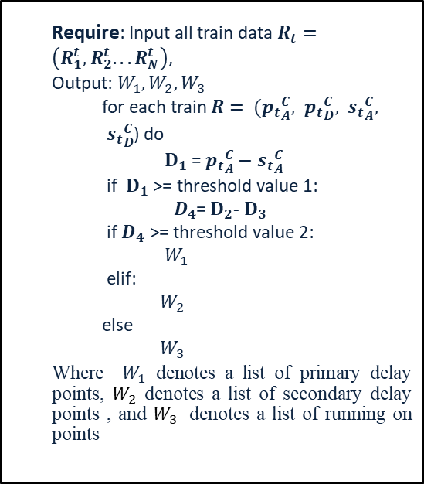
Critical Point Search Algorithm
Forward chaining would match critical point search rules into the knowledge base.
Critical point search rules:
The difference $D_{1}$ between the actual arrival time and the scheduled arrival time:
$D_{1}={p_{t}}_{A}^{C}−{s_{t}}_{A}^{C}$
The difference $D_{2}$between the actual arrival time and the actual departure time:
${{D_{2}=p}_{t}}_{A}^{C}−{p_{t}}_{D}^{C}$
The difference $D_{3}$ between the scheduled arrival time and the scheduled departure time:
$$D_{3}={s_{t}}_{A}^{C}−{s_{t}}_{D}^{C}$$
Compute the difference $D_{4}$between $D_{2}$and $D_{3}$:
$${ D_{4}=D}_{2}−D_{3}$$
An inference engine using forward chaining searches the critical point search rules until it finds one where the If clause $D_{1}$ >= the first threshold value $V_{1}$ and then $D_{4}$>= the second threshold value$V_{2}$. (Identifying the primary points.)
  Require: Input all train data $R_{t}=\left(R_{1}^{t},R_{2}^{t}...R_{N}^{t}\right)$,
  Output: $W_{1},W_{2},W_{3}$
    for each train $R= ({p_{t}}_{A}^{C}, {p_{t}}_{D}^{C}, {s_{t}}_{A}^{C},$ ${s_{t}}_{D}^{C}$) do
      $D_{1}$ =${p_{t}}_{A}^{C}−{s_{t}}_{A}^{C}$
    if $D_{1}$ >= threshold value 1:
      ${ D}_{4}$= $D_{2}$- $D_{3}$
    if $D_{4}$ >= threshold value 2:
      $W_{1}$
    elif:
      $W_{2}$
    else
      $W_{3}$
  Where $W_{1}$ denotes a list of primary delay points, $W_{2}$ denotes a list of secondary delay points , and $W_{3}$ denotes a list of running on points

Slide 96
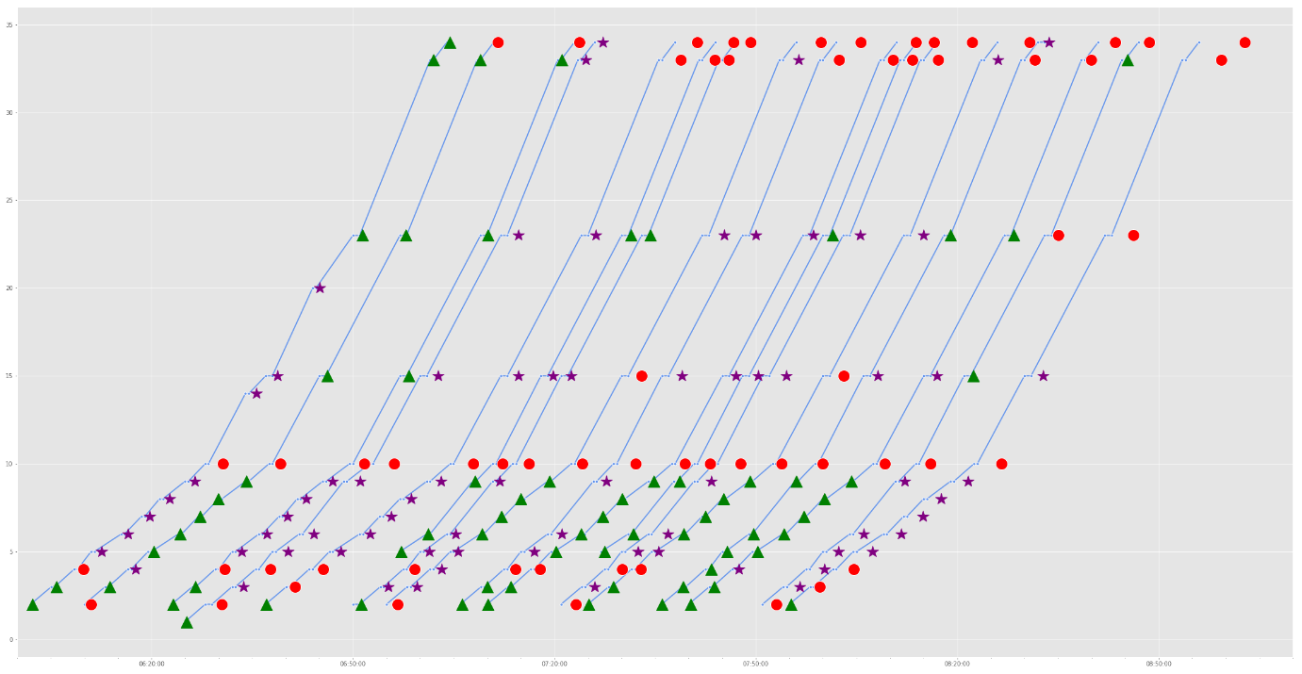
Critical Point Search Rules with FCA
Red: primary delay;
Purple: secondary delay;
Green: on time.

Slide 97
Critical Point Search Rules with FCA
A summary for the previous slide
Station primary delay : 62 (Extract the primary delay station with a delay greater than 60 seconds)
Station secondary delay : 72 (Drop the secondary delay station with a delay greater than 0 seconds)
Station running on time : 68 (Drop the on time running with no delay )
Primary delay Station：
The station Central was found 14 time(s).
The station Kingswood was found 2 time(s).
The station Parramatta was found 2 time(s).
The station Penrith was found 5 time(s).
The station Redfern was found 10 time(s).
The station Seven Hills was found 17 time(s).
The station Strathfield was found 2 time(s).
The station Werrington was found 10 time(s).
The rules can remove the secondary delays in order to perform accurate data extraction for primary delay prediction experiments.

Slide 98
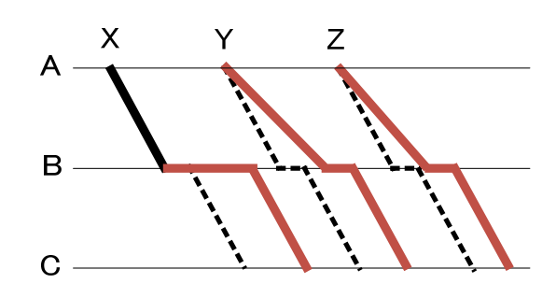
Critical Path Search Algorithm
Idea of train operation record network (TORN), a directed acyclic graph:
after our model predicts the delay of the entire transportation network, the condition of formula:
weight of the a critical predicted arc <= ( predicted time of the end node of the arc – predicted time of the start node of the arc) + offset
A. Yamamura, M. Koresawa, S. Adachi, and N. Tomii, "Identification of causes of delays in urban railways," Computers in Railways, vol. 13, pp. 403-414, 2013.

Slide 99
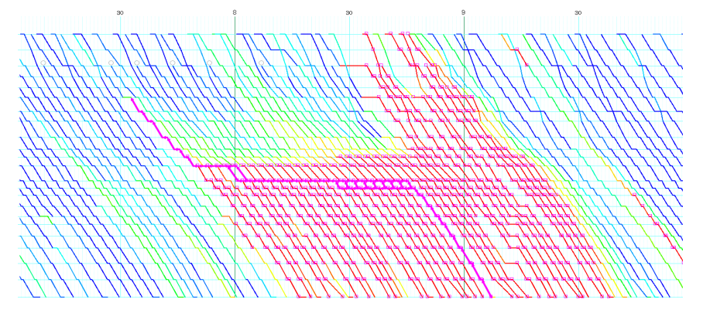
Critical Path Search Algorithm

Slide 100
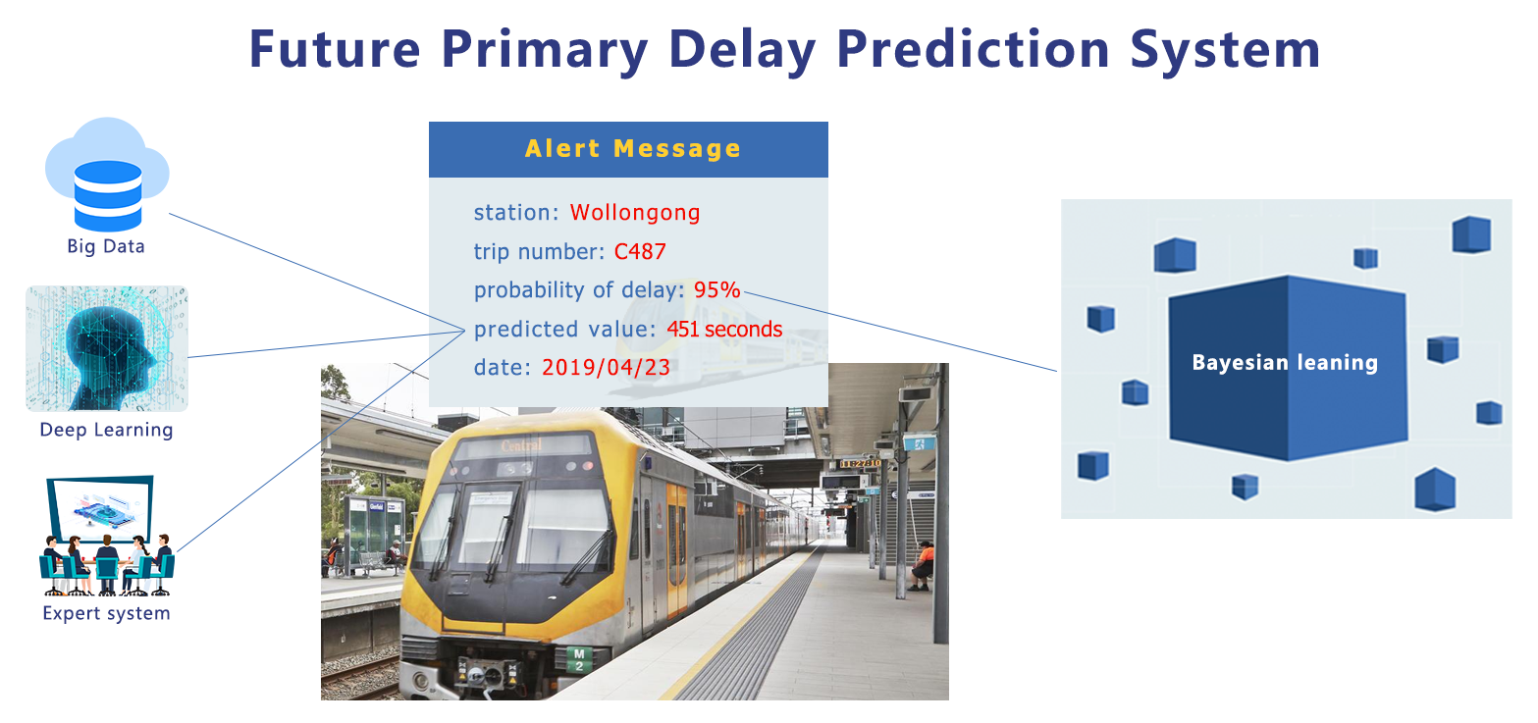

Slide 101
Summary
MLaaS, collaborated with CSIRO, UQ, UTS, SWU, SEU
PKaaS, collaborated with Monash
MaaS, collaborated with USyd, Sydney Trains, Data 61
  Acknowledgement:
  ARC Discovery Project 180101051, Taking Advantage of Invaluable Fragmented Time with Smart Micro Learning on Open Education Resources
  NSFC 2019-2022 (61872079), Research on the Edge Computing Execution Framework and Optimization Mechanism for Deep Learning Application
  NSFC 2019-2022 (61877051), Research on AI supported Adaptive Micro Learning
  Strategic Investments Grant., Cost-effective PHPPI prediction
  Sydney Trains
  Data 61, CSIRO

Slide 102

Questions?

